Slide 1
Personal Learning Graphs (PLeG)
George Siemens
UT Arlington
C3L: UniSA

Slide 2
1. Overview of Research
How people make sense of their world and act meaningfully in it, increasingly through distributed socio-technical cognition
Theoretical focus: Connectivism
Learning is networked at three levels: biological/neuronal, conceptual, physical/social. We can model it at each level and understand it through the same “vehicle”
It’s networks all the way down
Past and present: connectivism, MOOCs, learning analytics, affect and emotion, complexity science approach to learning
Contributions: Network approach to learning, digital/data lens on learning, scale and inclusion of technological agents in the learning process
Notes:
This slide should provide an overview of the presenter's research interest and how it relates to advancing Self-Improving Systems in ITSs
The overview should be succinct, using at most 20% of the presentation time

Slide 3
Background: What is the reality that we are trying to engage with?

Slide 4
Gallman & Weiss, 1969
Kendrick, 1961
BEA, 2010
Notes:
1840–1900: Robert E. Gallman and Thomas J. Weiss. "The Service Industries in the Nineteenth Century." In Production and Productivity in the Service Industries, ed. Victor R. Fuchs, 287-352. New York: Columbia University Press (for NBER), 1969.
1900–1940: John W. Kendrick, Productivity Trends in the United States. Princeton: Princeton University Press (for NBER), 1961.
1950–2010: Bureau of Economic Analysis, National Income and Product Accounts.
https://www.minnpost.com/macro-micro-minnesota/2012/02/history-lessons-understanding-decline-manufacturing

Slide 5
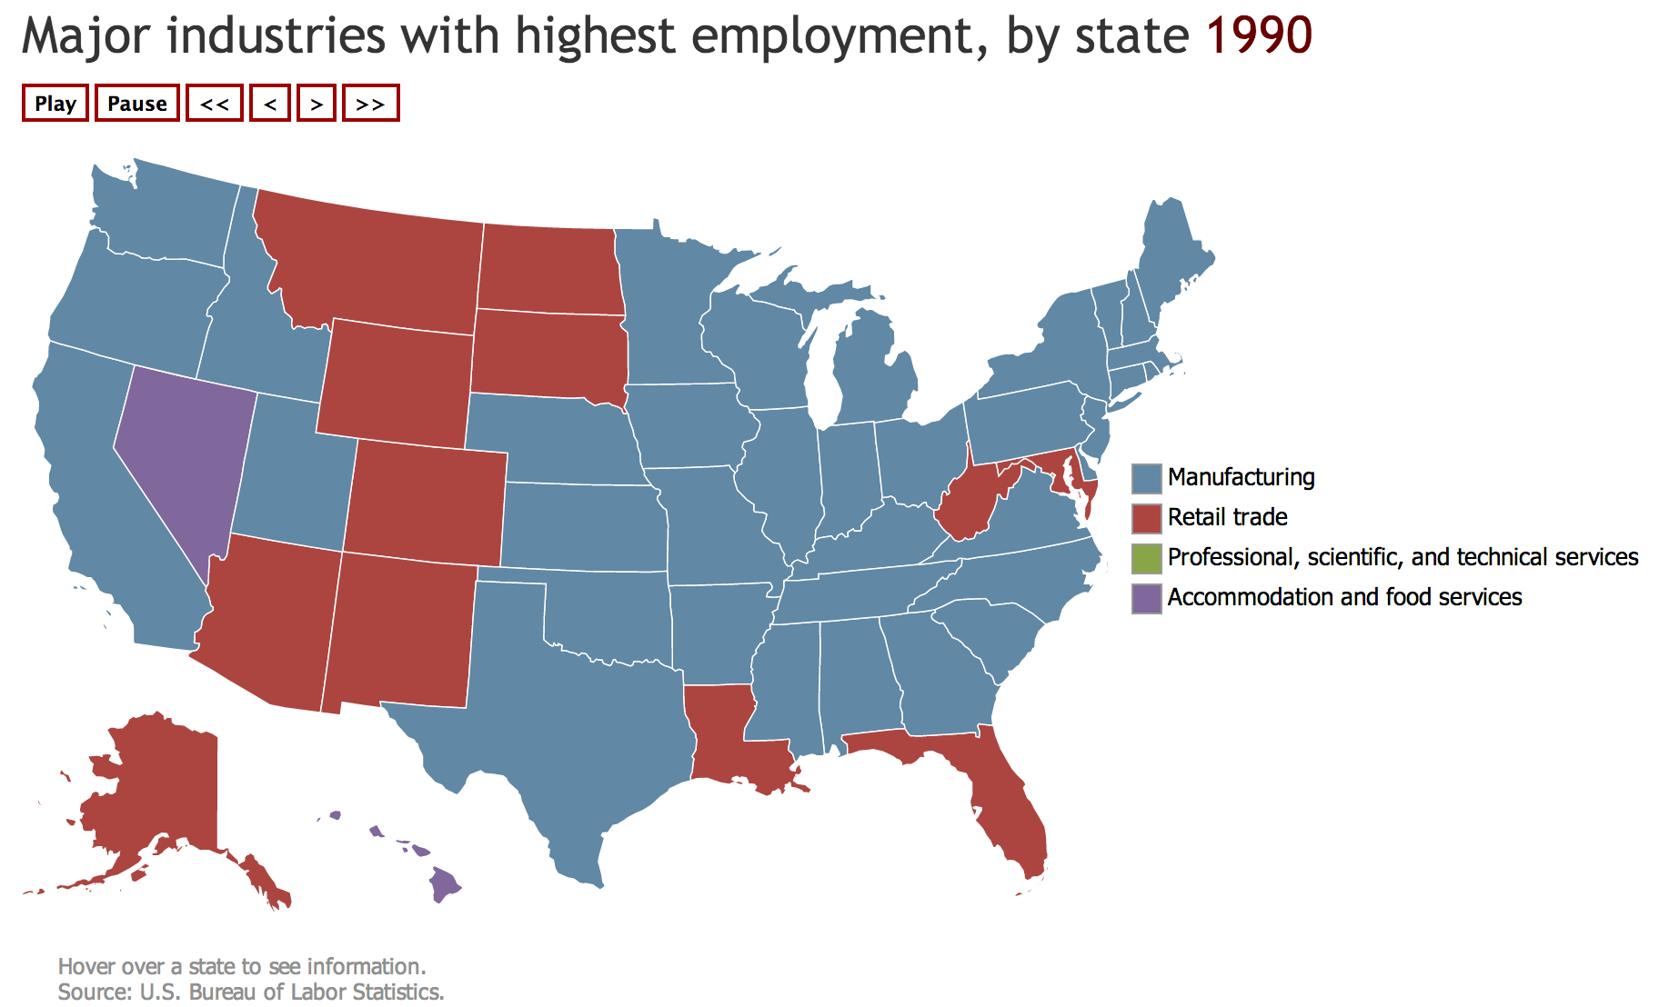
Notes:
http://www.bls.gov/opub/ted/2014/ted_20140728.htm

Slide 6
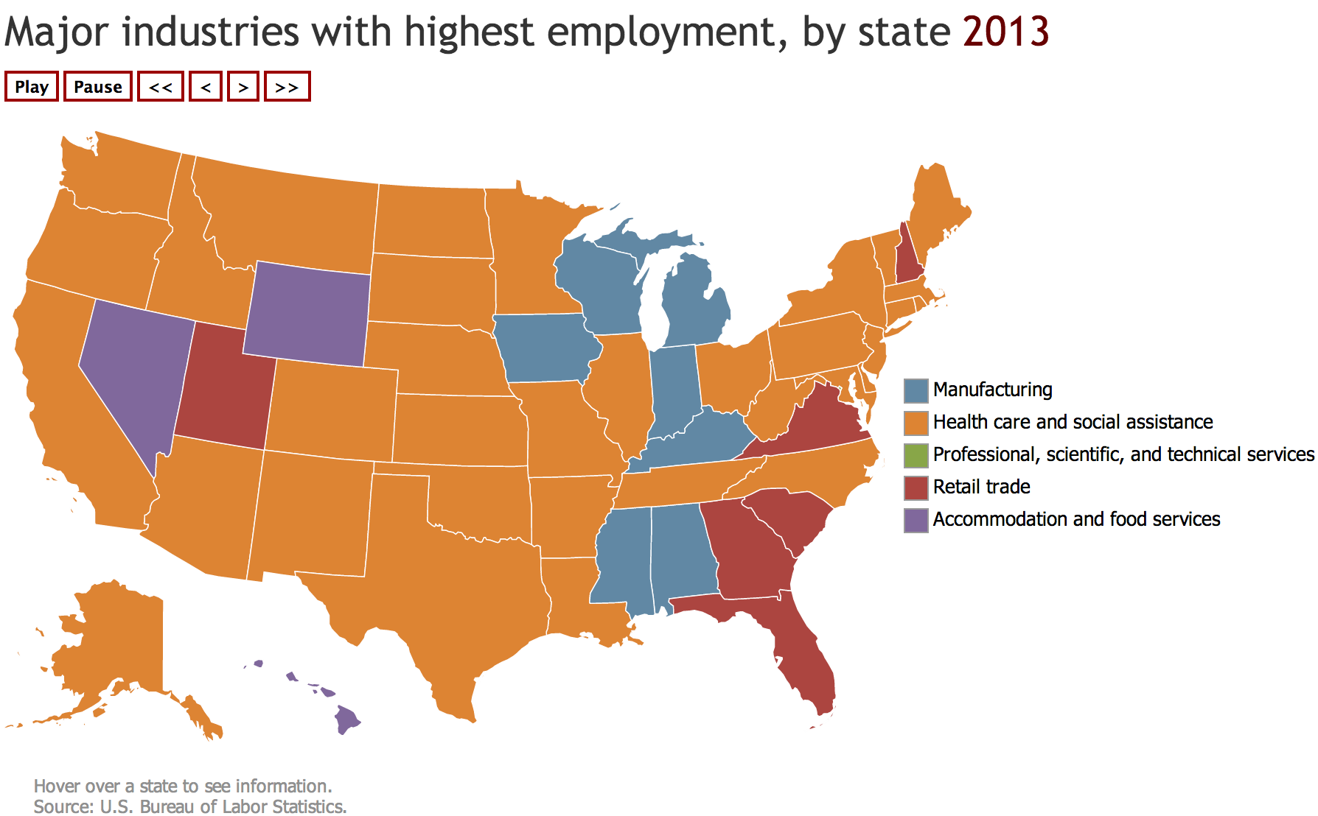
Notes:
http://www.bls.gov/opub/ted/2014/ted_20140728.htm

Slide 7
Notes:
https://www.techrepublic.com/article/report-59-of-employed-data-scientists-learned-skills-on-their-own-or-via-a-mooc/

Slide 8
How does this relate to modern knowledge needs?
Recognize the role of learning and broadening profile of learners
We require a theoretical lens that can take us “the distance”
We require a conceptual model that addresses application & practice, not only research
All personalized learning should begin with a sustained learner profile
Begin to see knowledge as no longer the exclusive domain of humans
A systems/complexity orientation enables us to evaluate how the pieces fit together and interaction
(see Siemens & Baker, 2012)

Slide 9
Technologies have shaped learner agency and self-regulation
Control is passed to the individual and this reality is not reflected in our campuses, our curriculum, or our teaching
Fragmenting knowledge presents an error correction challenge in teaching
Digital first – not reflected in classrooms and teaching practices

Slide 10
Crosslin, M., & Dellinger, J. (2015, March). Lessons learned while designing and implementing a multiple pathways xMOOC+ cMOOC. In Society for Information Technology & Teacher Education International Conference (pp. 250-255). Association for the Advancement of Computing in Education (AACE).

Slide 12
Specifically
We need to understand learners in context.
A networked and integrative theory of learner performance
The focus is on how humans and technology are intelligent together (distributed socio-technical cognition)
What type of technology infrastructure will replace the current education system?

Slide 13
System that is created needs to be:
Life long/wide/wise/deep
Accelerate degree completion/upskilling
Blur formal and informal learning
Respond to greater learner agency
Promote “skills of the future”
Learner owned
Holistic and reflective of complexity of learner and related contexts

Slide 14
Started with PLeG in 2014
But the model needed a different infrastructure
Content needed to be granularized
Breadth of learner assessment needed to be expanded

Slide 15
Projects to date
OnTask: Feedback
ProSolo: Learning infrastructure
Oval: Annotation/content creation
Current:
PLeG
Labor Market
Gap filling
Alternative credentialing

Slide 16
https://www.ontasklearning.org

Slide 18
2. A systemic view

Slide 19
What will AI/ML/LA do for education?
Automate mundane activities
Tutors/chatbots/student support
Improve communication
Higher quality contextual feedback
Personalized and adaptive learning
Learner profiles (personal learning graphs)
Social network expansion
Content and resource exploration

Slide 20
“Learning science researchers are paying more attention to affect and emotion, to students’ developing identities, to discourse and gesture, and to embodied cognition.”
Roschelle, J., Martin, W., Ahn, J. & Schank, P. (Eds.). (2017). Cyberlearning Community Report: The State of Cyberlearning and the Future of Learning With Technology. Menlo Park CA: SRI International.

Slide 21
PLeG
Social: (Bourdieu 1986, Coleman 1988, Putnam 1993, Bruner 1996, Bandura 1969, Freeman 1978, Haythornthwaite 2005, Scott 2012 )
Metacognitive: (Flavell 1979, Schunk & Zimmerman 2012, Pintrich 2000, Winne and Hadwin 1998, Winne 2011)
Affective: (Picard et al. 2004, Pekrun, Goetz, and Titz 2002, Baker et al. 2010, D’Mello & Graesser 2012, Bower et al. 1981, Pekrun et al. 2011, Mazer et al. 2007, Immordino-Yang & Damasio 2007 )
Cognitive: (Moreno & Mayer 1999, Brown, 2000, Greeno, Collins, & Resnick 1996, Anderson 1996, etc)

Slide 22
Updating?
Mapping labor market trends
LinkedIn and similar sites: snapshots and provisional acceptance of skills
Granularize content so skill gaps can be addressed

Slide 23
A few examples:

Slide 24
IDEAS Center
UTA: 5th most diverse campus in USA
Large transfer population
What US will look like in the future
Concerns aren’t cognitive, they are life-based

Slide 25
AerosPACE/AstroPACE
Team-based
7 universities, 10 learners each
Faculty and industry oversight
Plan-build-fly
Can we sustain life on Mars?
Inter-disciplinary
Problem oriented
Creativity and innovation

Slide 26
Ability to develop affect skillsets
Curriculum on developing social, affective, metacognitive skills.
Evaluate impact within PLeG: i.e. how do mindsets and goal orientation and setting and monitoring impact other domains in PLeG
With Mills, Dowell

Slide 27
Learner psychological profile
EDM 2018: Understanding the broader profile of our learners
Kizilcec, R. F., Piech, C., & Schneider, E. (2013, April). Deconstructing disengagement: analyzing learner subpopulations in massive open online courses. In Proceedings of the third international conference on learning analytics and knowledge (pp. 170-179). ACM.

Slide 28
Demographics (age, gender, education, difficulty paying bills);
Self-efficacy, beliefs, and intentions
Global mental and physical health (Patient-reported outcomes measurement information system);
Curiosity and exploration (curiosity and Exploration Inventory II);
Emotion Regulation (Emotion Regulation Questionnaire);
Mindfulness (Five Facet Mindfulness; Well-Being (Psychological Well-Being);
Stress (Perceived Stress Scale);
Sense of self (Sense-of-Self Scale;
Personality (Ten Item Personality Inventory)

Slide 29
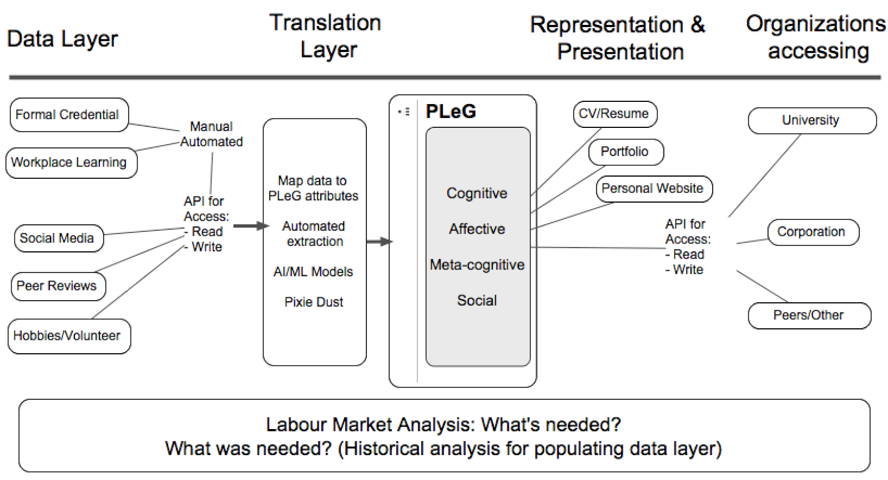

Slide 30
What data we collect?
Survey
Questionnaire
Interview
Focus groups
Ethnography
Student profile/Demographics
Lesson planning
Scheduling
Enrolment
Assignments
Campus attendance
Academic data
Instruments
Student Information
System
Video
Audio
Gesture
Gaze
Psychophysiological data
EEG
fMRI
Multimodal
Trace data
Simulation data
Assessment
Social interaction
Content interaction
Intelligent tutoring system
Educational context data
Learning Environment
Social Media
Twitter
Facebook
Blog
Library Management
System
Library attendance
Lesson Library use (loan reports)
Library helpdesk
e-book
journals
applications
Third-party
Srecko Joksimovic, 2018

Slide 31
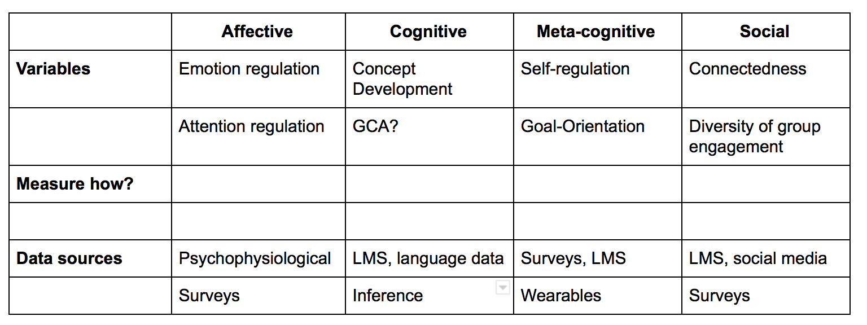

Slide 32
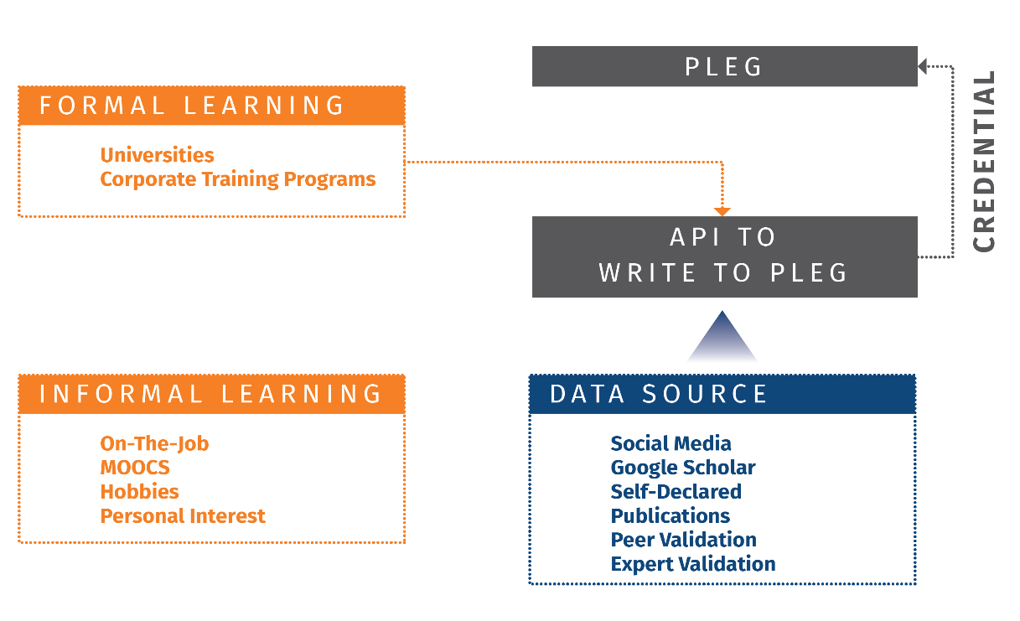

Slide 33
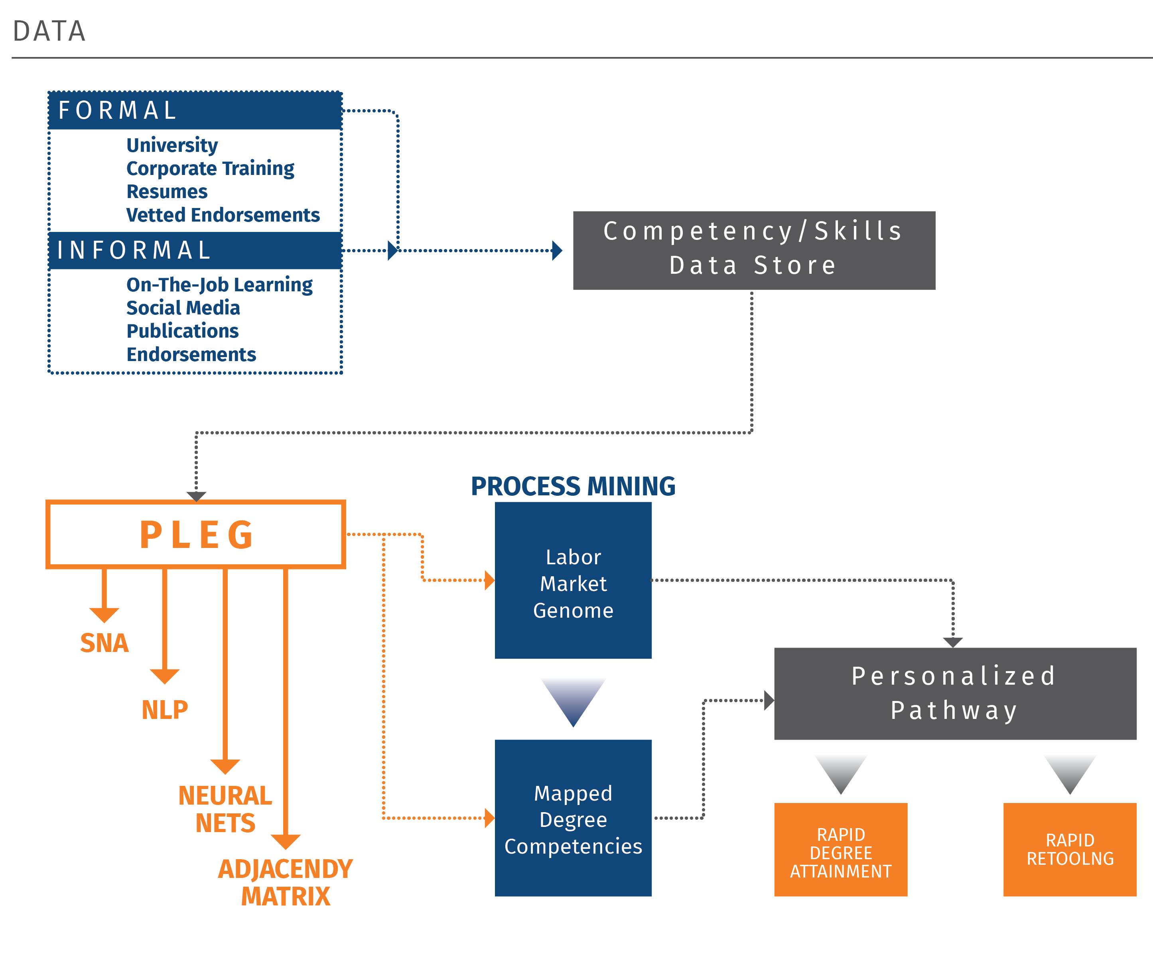

Slide 34
The challenge of CBE, profile building
Data integration and updating are too onerous
Used on numerous MOOCs
K-12 teachers
Corporate environments
SRL is challenging for many learners (lack skills and confidence)
We are entering a post-learning world

Slide 35
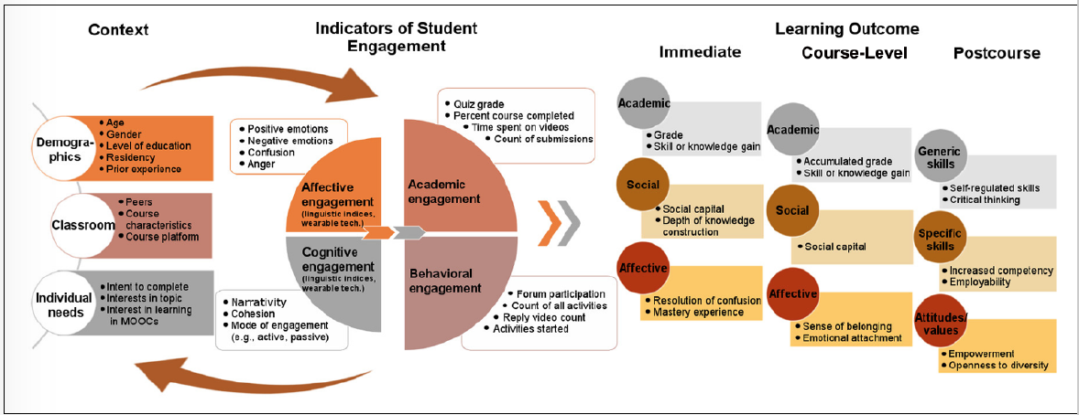
NSF: COCOA Grant
Joksimović, S., Poquet, O., Kovanović, V., Dowell, N., Mills, C., Gašević, D., ... & Brooks, C. (2018). How do we model learning at scale? A systematic review of research on MOOCs. Review of Educational Research, 88(1), 43-86.

Slide 36
3. Relevance to higher education
Develop PLeG approaches in corporate/higher education models
Develop data structures that map to most significant aspects of learner attributes (affective/social/metacog)
Operationalization of PLeG across multiple spaces: MOOCs, BB, classrooms
Notes:
This section may focus on their startegy relevance to GIFT specifically, or to an idealized general tutoring system.

Slide 37
4. Conclusions & Recommendations
Development/inclusion of consistent learner profiles/models
Develop and evaluate learners by attributes that are not duplicatable by technology
Focus on broader knowledge system and the ways in which today’s learning needs (society, corporate, learning) impact the structure of what we do
Build the system rather than research within it
Develop a focus LS and LA research strand in how humans and technology are intelligent together

