Slide 1
Multinomial Processing Tree Model
Bill Batchelder’s Session on Cognitive Psychometrics
These Slides will cover MPT models in two parts: 1. Model specification, 2. Statistical inference
Feel free to ask questions any time.

Slide 2
AGENDA Part 1. MPT Model Specification
I. Orientation to MPT Models
II. Review of MPT models
A. Examples
B. Binary MPT Model Specification
C. Critical Issues
III. Brief Survey of MPT Modeling Areas
IV. Statistical Inference for MPT Models
V. A String Language Representation of MPT Models

Slide 3
I. Orientation to MPT Models
Myself and students at UCI have been developing and analyzing MPT models for at least 25 years. David Riefer and I got started in the late 1970s, and Xiangen Hu added a lot of mathematical savvy to the project in the 1900s.
Originally we worked with particular models, but by the late 1980s we realized that we were making the same moves over and over again. That led us to formalize the entire class of MPT models and look for general class properties and general methods of inference.
Now MPT modeling is a very active area, e.g. Special Issue Zeiutschrift fur Psychologie 2009 on MPT Modeling

Slide 4
Model Specification and Statistical Inference
When studying a class of parametric statistical models it is important to differentiate model specification from statistical inference.
1. Specified models generate probability distributions over the data space as a function of the model’s parameters.
2. Statistical inference for a model assumes given data and makes inferences about the parameters that generated it.
In the first part I will concentrate on model specification, and in part 2 say some things about inference. Jay Myung’s session will cover much more about inference in a more general setting than just MPT.

Slide 5
II. Review of MPT Models
MPT models are a class of parametric models with all sorts of interesting statistical and mathematical properties:
1. Simple, pragmatic, approximate
2. Specification and Inference machinery at the class level
3. Open to experimental validation
In some cases MPT models are approximate scientific explanations for cognitive phenomena, and in other cases they provide the basis for model-based measurement of cognitive capacities.
Batchelder, W.H. (1998). Multinomial processing tree models and psychological assessment.
Psychological Assessment, 10, 331-344.
Batchelder, W.H. Cognitive Psychometrics: Using Multinomial Processing Tree Models as Measurement
Tools. In S. E. Embretson (Ed.). Measuring Psychological Constructs: Advances in Model Based
measurement. Washington DC: American Psychological Association Books, 2009, Ch.4.

Slide 6
Comparing Cognitive and Psychometric Modeling
Psychology has two subareas where statistical modeling is important: cognitive modeling and psychometric modeling.
Unfortunately as I explained in my earlier session there is very little cross talk between cognitive and psychometric modelers.
I view MPT models as combining some of the the best aspects of both of these subareas. So lets take a brief view of these contrasting styles in modeling.
My Lab is called Cognitive Psychometrics

Slide 7
Comparing Modeling Strategies
Cognitive models have parameters for latent cognitive processing events, e.g. learning rate, memory storage, attention spread, response bias, signal detection, similarity, inference, retrieval.
They typically lack parameters explicitly associated with participants or items.
This Gap is Rapidly Closing! See Recent Issue on HIERARCHICAL MODELING in J. Math. Psych. Feb. 2011 Edited by Michael Lee
Psychometric models have parameters explicitly associated with participants or items, e.g. participant ability, item difficulty, and item discriminability. They typically lack parameters for latent cognitive processing acts that tap knowledge structures to generate test responses.
MPT models have parameters that tap cognition, and recently they are being augmented with participant and item parameters.

Slide 8
Comparing Modeling Strategies
Cognitive modelers view modeling as a theoretical endeavor to discover common properties of the normal mind/brain.
Psychometric modelers view modeling as a way to measure individual differences in latent traits such as ability, personality, and attitude.
MPT unlike most posychometric models are not based on standard linear assumptions. Instead they assume a special conditional language, where the outcome of one cognitive act can determine the next act to be encountered on the route to a manifest response.

Slide 9
More Differences
Cognitive models are often pitted in competition over their ability to fit very specific aspects of data. When a cognitive model fails to fit these aspects, it is usually either passed over or elaborated to meet the task.
Psychometric models are rarely pitted in competition.
When a psychometric model fails to fit data, one usually narrows the testing conditions for its applicability.
MPT models are designed for very specific paradigms. When an MPT model fails, I like to narrow the domain of its applicability rather than elaborate it.

Slide 10
IIA. Example Tree Model: ABO Blood Group
DAD
^{KEY CONCEPTS}
^{1. Rooted Tree, root}
^{2. Internal nodes, leaves}
^{3. Latent parameters to}
^{internal nodes}
^{4.} ^{Manifest categories to leaves}
^{5. 3 df, 2 parameters}
^{6. Many-one branches to}
^{categories}
^{SIMPLIFYING ASSUMPTIONS}
^{Gene pool equilibrium}
^{No mate selection}
p
q
r
MOM
p
q
r
p
q
r
p
q
r
A
AB A AB B B A B O
0<p,q<1
p+q+r=1
Pr(A) = p²+pr+rp
Pr(AB)= pq+qp
Pr(B) = q²+qr+rq
Pr(O) = r²
Is a parameterized multinomial

Slide 11
Example: The Pair Clustering Model
Participants study a list of words and they are later tested in a free recall experiment.
The list consists of clusterable pairs (e.g. oxygen, hydrogen; daisy, rose ; beer, whisky).
Pairs are scored into four observable categories:
E₁- Both words recalled adjacently
E₂- Both words recalled non-adjacently
E₃- One and only one word recalled
E₄- Neither word recalled

Slide 12
The Pair-Clustering Tree
Published in Batchelder & Riefer ( British Journal of Statistical & Mathematical Psychology, 1986; Psych Rev, 1980 )
Parameters
c- prob. of forming a cluster
r- prob. Retrieving a cluster
u- prob. Storing and retrieving
a non-clustered word
0<c, r, u< 1
Category Probabilities
Pr(E₁)=cr; Pr(E₂)=(1-c)u²
Pr(E₃)=(1-c)u(1-u)+(1-c)(1-u)u
c
1-c
u
1-u
r
1-r
u
1-u
u
1-u
E₁ E₄ E₂ E₃ E₃ E₄
Categories
Model is simple. Makes approximations: only clustered pairs lead to E₁ , non clustered
items independent. Model has 6 branches, 4 categories, 3 df, 3 latent parameters

Slide 13
Origin of the Pair-clustering Model
In free recall repeating a word in the study list obviously increases its probability of recall, but what is the effect of lag between repeats? Word list: ------ Barn—lag k—Barn------
Answer- Recall probability of ‘Barn’ increases with lag
In free recall introducing a categorically related word like ‘house’ increases the probability of recalling ‘barn’ but what is the effect of lag? Word list: ----Barn—lag k—House---
Answer- Inconsistent across experiments. Our theory- short lags increase the probability that ‘Barn’ and ‘House’ are stored in memory as a cluster (parameter c), but long lags increase the conditional probability that a stored cluster is retrieved (parameter r).

Slide 14
Example: MPT Model for Source Monitoring
In a typical source monitoring experiment subjects study a list of words with items from two sources A and B (male or female voice, auditory or visual). A memory test includes the studied words along with new distracters, and to each test word the subject must indicate ‘Old A’, ‘Old B’, or ‘’New”
If we assume the words within a test type are i.i.d. within a subject, the data structure for each subject is a product trinomial with frequency table-
^{Test Response}
Researcher
sets these
Subject i | A | B | N
A | f_{AA} | f_{AB} | f_{AN}
B | f_{BA} | f_{BB} | f_{BN}
New | f_{NA} | f_{NB} | f_{NN}
F_{A}
^{Item type}
F_{B}
F_{N}

Slide 15
A Model for Two Sources
Batchelder & Riefer (1990, Psychological Review)
.
SOURCE B
SOURCE A
3(3-1)=6 df
7 parameters
D_{B}
1-D_{B}
D_{A}
1-D_{A}
d_{B}
1-d_{B}
b
1-b
d_{A}
1-d_{A}
b
1-b
a
C_{N}
C_{B}
1-a
g
1-g
C_{A}
C_{N}
a
1-a
g
1-g
C_{A}
C_{B}
C_{A}
C_{B}
C_{A}
C_{B}
C_{A}
C_{B}
NEW
Examples of the nine equations
b
1-b
D- detect old
d- discriminate source
b- ‘false alarm’
a,g- guess source A
C_{N}
g
1-g
C_{A}
C_{B}

Slide 16
Sub-Models Based on Equating Parameters
Clearly a model with 7 parameters and 6df in the data is not ‘identified’. Informally, a parametric model is globally identified if it is never the case that two distinct values of its parameters generate the same probability distribution over the observed data.
Identification is essential if one’s goal is to measure the underlying parameters from observed data.
To identify the model one can use one or more of the following restrictions:
See Batchelder & Riefer (1990)
Psych. Rev. for details

Slide 17
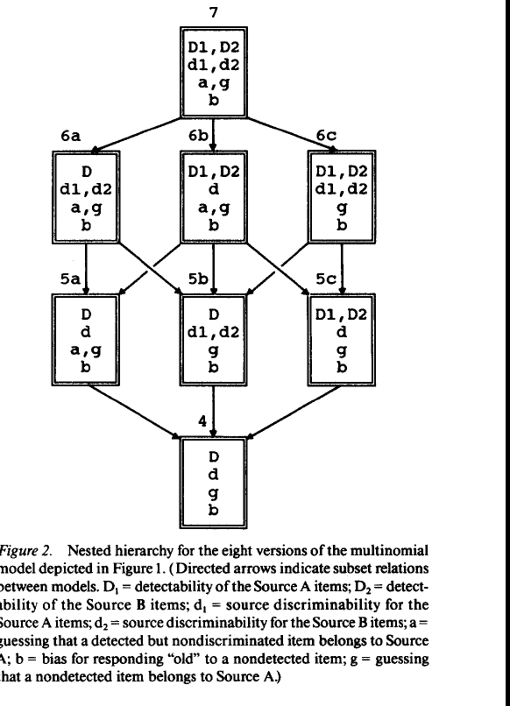
One of the arrows is
wrong can you find it?
Xiangen Hu developed
a graphic user interface (GUI)
that could accept product
trinomial data, select one
version of the model and
estimate parameters and
Test goodness-of-fit.

Slide 18
A Model for Three Sources
11 parameters 12 df

Slide 19
II. B. Binary MPT (BMPT) Model Specification
There are four aspects to a BMPT model:
Observable response categories
Latent cognitive parameters
Tree architecture
Computation rules
Each BMPT model has two or more observable response categories, C₁, C₂, …, C_{J}.

Slide 20
An MPT model has one or more functionally independent latent parameters, , each representing the probability of a particular cognitive act, where is the failure probability.
The parameter space Ω for the model parameters Θ with S parameters is
This exhibits the fact that the parameters are functionally independent with each free to vary in (0,1)

Slide 21
The tree structure is a full binary tree (FBT) with a single initial node (the root), intermediate nodes, and terminal nodes (the leafs). All intermediate nodes have exactly two children and all nodes but the root have exactly one parent
If is in the FBT, is a parent of and
is a child of
Associated with each non-terminal node is a parameter
( or a number x in (0,1)). Associated with each leaf is a category
Each non-terminal node has two links that correspond, respectively, to the success or failure of the cognitive act represented by (or x).
Parameters and categories can occur several times in a tree, and the numerical links are there to join trees or represent hypotheses.

Slide 22
The final aspect of an MPT model are the computational rules that compute category probabilities in terms of the parameters.
Each tree consists of a set of branches each terminating in a category. Branch probabilities are products of link probabilities.
This rule represents a Markovian assumption of the sort seen in probabilistic automata, e.g.

Slide 23
The Pair-Clustering Tree
Published in Batchelder & Riefer ( British Journal of Statistical & Mathematical Psychology, 1986; Psych Rev, 1980 )
Parameters
c- prob. of forming a cluster
r- prob. Retrieving a cluster
u- prob. Storing and retrieving
a non-clustered word
0<c, r, u< 1
Category Probabilities
Pr(E₁)=cr; Pr(E₂)=(1-c)u²
Pr(E₃)=(1-c)u(1-u)+(1-c)(1-u)u
c
1-c
u
1-u
r
1-r
u
1-u
u
1-u
E₁ E₄ E₂ E₃ E₃ E₄
Categories
Model is simple. Makes approximations: only clustered pairs lead to E₁ , non clustered
items independent. Model has 6 branches, 4 categories, 3 df, 3 latent parameters

Slide 24
General Computational Formula for BMPT Models
a_{ks} and b_{ks}, respectively, are the number of occurrences of θ_{s}
and (1-θ_{s}) on branch k and c_{k} is the product of the numbers on numerical links or set to one if there are no numerical links on branch k.
Branches map many-one into categories, so category probabilities are sums of branch probabilities.
where and I_{j} is the number of branches
leading to C_{j}, j=1,...,J.

Slide 25
Given this structure it is to see that for every
, category probabilities satisfy
Thus if category counts, <N_{j}>, are obtained
under i.i.d. conditions, then each BMPT leads to a
parameterized multinomial distribution, where

Slide 26
II.C Critical Issues
Building a useful MPT model is an art. One has to :
1. Decide what aspect(s) of cognition one wants to measure,
and think of a simple, non-trivial paradigm that results in
relevant data.
2. Find a clever way to get enough categories. Too many leads
to sparse counts, too few leads to a non identified model, e.g.
story behind the pair-clustering model.
3. Sense the critical cognitive components behind a
categorical response, and agree to neglect the others.
4. Resist the temptation to try and expand the model to
cover more and more aspects of cognition.
5. Think of multi-group experiments where one can equate
some parameters across groups to increase #CATS/#PARMS

Slide 27
Validity
Throughout the development of MPT modeling it has been essential to argue that the parameters are actually tapping the latent processes they are said to tap. This is not a statistical question of data fitting.
Eg. Pair-Clustering Model- does r really measure cluster retrieval?
Lately all MPT papers I have seen that develop new models have a heavy dose of validity studies based on ‘selective influence’ in them. This is essential to carry out cognitive psychometrics
Rich Schweickert has taken the study of validity based on selective influence to a higher level, e.g. Schweickert, Fisher, and Sung (2012) Discovering Cognitive Architecture by Selectively Influencing Mental Processes. World Scientific Publishing

Slide 28
What Happened to Multi-link MPT Models?
Theorem: It turns out that every multi-link MPT model (MMPT) one that allows internal nodes to have 2 or more children) is statistically equivalent to a BMPT.
Informally two models of categorical data are statistically equivalent if they entail exactly the same set of probability distributions over the data categories.
Suppose J categories, then the set of possible probability distributions is given by the simplex on J categories-

Slide 29
Formal Definitions of Statistical Equivalence
Let represent a parametric model on J categories, with parameter
space . Then there is a function
that is
Let be the range of h .
Defn. Two models on J categories, and
are statistically equivalent if
Defn. A model on J categories, ,is globally identified in case
h₁ is one-to-one
NOTE: Any parametric statistical model has many statistically equivalent versions each with different parameters, that’s why validity studies are important.

Slide 30
ABO Blood Group Revisited
DAD
p
q
r
MOM
p
q
r
p
q
r
p
q
r
A
AB A AB B B A B O
0<p,q<1
p+q+r=1
Pr(A) = p²+pr+rp
Pr(AB)= pq+qp
Pr(B) = q²+qr+rq
Pr(O) = r²
Is a parameterized multinomial

Slide 31
The BMPT Equivalent ABO Blood Group Model
For example
ABO Model in BMPT Form
p*
1-p*
θ
θ + (1-p*)p*
p*
θ
1-p*
1-θ
=p(1-p)q/(1-p)+(1-p)pq/(1-p)
=2pq
Same as for the ABO Blood
Group Model earlier
θ
C_{A}
1-θ
p*
1-p*
p*
1-p*
C_{AB}
C_{A}
C_{AB}
θ
C_{A}
θ
1-θ
1-θ
C_{B}
C_{B}
C_{B}
C_{O}
New parameters: 0<p*, θ <1
p*=p, θ =q/(1-p)

Slide 32
III. Brief Survey of MPT Modeling Areas
The Batchelder & Riefer (1999) and Erdfelder et al (2009) in your suggested readings contain almost all of the MPT modeling papers. The Erdfelder article lists 70 MPT models and model variants in 20 separate research areas.
Just in memory we have:
1. Proactive and retroactive interference; 2. Associative recall
3. Short term memory; 4. Recognition failure
5. Cued-then-free recall; 6. Pair clustering in free recall
7.The bizarreness effect; 8. Source monitoring
9. Process dissociation; 10. Eyewitness memory
11. Hindsight bias; 12. Prospective memory;
13. Gist and verbatim memory

Slide 33
Some New Areas of Applications
There is now a growing set of applications to clinical assessment problems. Richard Neufeld has an APA book in 2007 that has articles by Batchelder and Riefer and Richard Chechile on such applications, also see also articles by Chechile and Smith& Batchelder in a 2010 Special Issue of JMP on modeling clinical data.
Recently Batchelder, Hu, and Smith (2009). MPT models for discrete choice , Zeitschrift für Psychologie, 217, 149-158.
have ventured into the area of paired-comparison scaling with MPT.
There have been many recent applications to problems in social psychology. Thorsten Meiser, Christolph Klauer, and Christolph Stahl have done a lot of it, and Stahl (2006, Zeitschrift für Sozialpsychologie) has a review article in this area- in German!

Slide 34
More New Areas
There have been applications in traditional psychometric areas, e.g. Cultural Consensus Theory (CCT) I will have separate slides on that.
Also see Batchelder, W.H. Cognitive Psychometrics: Using Multinomial Processing Tree Models as Measurement Tools. In S. E. Embretson (Ed.). Measuring Psychological Constructs: Advances in Model Based
Measurement. Washington DC: American Psychological Association Books, 2009, Ch.4.
A major work in progress by Xiangen Hu and others concerns applications to contingency tables, e.g. social mobility. There aren’t ‘items’ here but each row has the columns as its categories. These models look promising and extend the work of Leo Goodman on log-linear models and Clifford Clogg on latent class modeling of contingency tables.

Slide 35
A String Language Representation for MPT Models
Purdy and Batchelder (2009, J. Math. Psychol.) have looked at BMPT models, and we found a very succinct formal representation for them.
The result is a string language that represents a BMPT very efficiently as a string of parameter and category symbols.
The string language is shown formally to derive from a context free grammar (see paper), and as a consequence it inherits properties of this class of languages.

Slide 36
BMPT Models Defined by 5 Axioms
Formation Axioms
Let C be a class of categories and Θ, disjoint from C, a class of functionally independent parameters each free to vary in (0,1). Then the class B of BMPT models satisfies the following 5 axioms
Axiom 1: (Category Membership) If C ε C, then C ε B
Axiom 2: (Tree Construction) If M, M' ε B & θ ε Θ, then θMM' ε B.
Axiom 3: (Tree Deconstruction) If M in B-C, then there are M',M'‘ ε B & θ ε Θ such that M= θM'M''.
(Proposition: The tree deconstruction in Axiom 3 is unique.)
Notes:
Be able to explain each Axiom intuitively.
Axiom 3 prevents other things from appearing in the class B. The breakdown must be unique.

Slide 37
Response Axioms
Axiom 4:
Axiom 5: If M=θM’M’’ for M,M’,M’’ ε B and θ εΘ, then
These five axioms generate strings of parameter and
category symbols, and the strings can be shown to be
one-to-one with the class of BMPT models viewed as
properly parameterized full binary trees (FBTs).

Slide 38
Some Examples of Tree to Strings
Consider the binomial (N, p). Some strings are:
N= 1: pC₁C₀
p
1-p
C₁
C₀
N=2: ppC₂C₁pC₁C₀; N=3; pppC₃C₂pC₂C₁ppC₂C₁pC₁C₀
p
From the usual parameterized FBT
one does a ‘Preorder Traversal’ to
generate the string (Preorder Traversal:
visit the root of each subtree before visiting its
other children)- see Purdy Batchelder paper
1-p
p
p
1-p
1-p
C₂
C₁
C₁
C₀

Slide 39
Does Anyone Recognize This Model?
c
1-c
r
1-r
u
1-u
C₁
C₄
1-u
1-u
u
u
C₂
C₃
C₄
C₃
The BMPT structure from the string crC₁C₄uuC₂C₃uC₃C₄

Slide 40
Strings for The Example Models
.
SOURCE A Model
ABO Model in BMPT Form
p*
1-p*
D_{A}
1-D_{A}
p*
θ
1-p*
1-θ
C_{A}
θ
p*
p*
1-θ
1-p*
1-p*
d_{A}
1-d_{A}
b
1-b
C_{AB}
C_{A}
C_{AB}
θ
C_{A}
θ
C_{N}
1-θ
1-θ
C_{A}
g
1-g
C_{B}
a
1-a
C_{B}
C_{B}
C_{O}
C_{A}
C_{B}
C_{A}
C_{B}
New parameters: 0<p*, θ <1
p*=p, θ =q/(1-p)
p*p*C_{A}θC_{AB}C_{A}θp*C_{AB}θC_{B}C_{B}p*C_{A}θC_{B}C_{O}

Slide 41
The Representation Theorems
THM.1 A finite string of parameter and category symbols corresponds to a BMPT model generated by the formation axioms iff it starts with a parameter symbol and a left-to-right running count of the difference between the parameter and category symbols is never negative until the end symbol is counted to make the running count - 1.
THM.2.(Informally stated) The class of BMPT strings and associated parameterized category probabilities is in one-to-one correspondence with the set of properly parameterized full binary trees with associated parameterized category probabilities.

Slide 42
Strings for The Example Models
.
SOURCE A Model
ABO Model in BMPT Form
p*
1-p*
D_{A}
1-D_{A}
p*
θ
1-p*
1-θ
C_{A}
θ
1-θ
p*
1-p*
p*
1-p*
d_{A}
1-d_{A}
b
1-b
C_{AB}
C_{A}
C_{AB}
θ
C_{A}
θ
C_{N}
1-θ
1-θ
C_{A}
g
1-g
C_{B}
a
1-a
C_{B}
C_{B}
C_{O}
C_{A}
C_{B}
C_{A}
C_{B}
p*p*C_{A}θC_{AB}C_{A}θp*C_{AB}θC_{B}C_{B}p*C_{A}θC_{B}C_{O}
1, 2, 1, 2, 1, 0,1,2,1, 0, -1
Left to right count
1,2, 1, 2, 1, 0,1,2, 1, 2,1, 0,1, 0,1, 0, -1
left to right count
Note: When the running count is zero, this indicates a component BMPT model in the decomposition M=θM₁M₂

Slide 43
Properties of The String Language
The paper uses the context free properties of the language to do a lot of things, e.g. count models with certain properties, study special subclasses, etc. At minimum it is an efficient way to represent models for computational algorithms.
Ongoing Work: 1. Generalize to Multi-Link MPT Models
2. Develop string transformation rules to
represent order constraints on parameters (see later)
3. Use the representation to explore the
relationship of MPT models to hidden Markov chains and Bayes nets.

Slide 44
Parametric Order Constraints for BMPT Models
Generally one is interested in hypotheses that involve restrictions on the parameters of a BMPT model either across conditions or within a condition.
It is helpful though not necessary that the constrained model,
which is now not a BMPT model, is statistically equivalent to an unconstrained BMPT model with no increase in parameters
Hu and Batchelder (1994, Psychometrika) handle dimension
reducing constraints, e.g. , in this way
Knapp and Batchelder (2004, JMP) handle in this way some order constraints for BMPT of the form

Slide 45
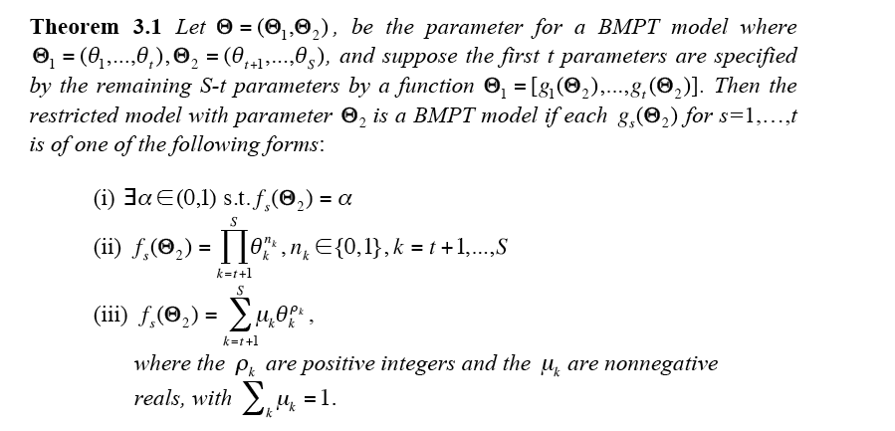
Xiangen’s Theorem

Slide 46
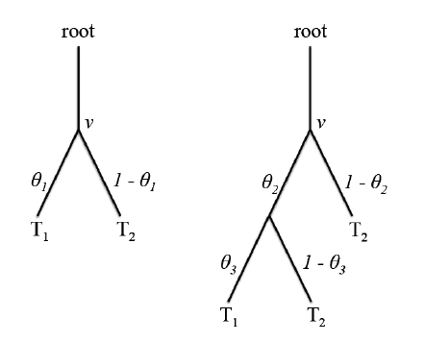
Example of Xiangen’s Theorem Part (ii.)
Suppose one has a BMPT model and wants to test the hypothesis that . Under this constraint the model is not a BMPT model, but it is statistically equivalent to one as illustrated. One replaces each node with as follows :

Slide 47
Handling A Simple Order Constraint
Introduce:
M
M’
M’
M
M’
Let S,,T be substrings of parameters and categories and M, M’
BMPT model string submodels of ; then the model string selecting on a is given by and the order constraint can be accommodated
in the BMPT string language by the transformation rule
M and M’ can be extracted automatically with a push-down automaton associated with the context free language (see Purdy Batchelder)

Slide 48
String Language for Multi-link MPT (MMPT) Models
It is straightforward to extend the axioms for BMPT models to cover MMPT models (Purdy, PhD Dissertation, 2009).
Parameters assigned to non-terminal nodes of a rooted tree are now vectors of k>1 components, parameterizing pdfs over k atoms, corresponding to the k children of the node they are assigned to.
In the axioms parameters are denoted by
and now BMPT parameters have k=2,

Slide 49
MMPT Models Defined by 5 Axioms
Let C be a set of categories and Θ, disjoint from C, be a set of functionally independent parameter vectors each with
components. Then the corresponding class of MMPT models is defined by the following five axioms.
Formation Axioms
Axiom 1: (Category Membership) If then
Axiom 2: (Tree Construction) If & then
Axiom 3: (Tree Deconstruction) If M in B-C, then there is .
Notes:
49
Be able to explain each Axiom intuitively.
Axiom 3 prevents other things from appearing in the class B. The breakdown must be unique.

Slide 50
Response Axioms
Axiom 4:
Axiom 5: If then
As before for the BMPT axioms, the decomposition in
Axiom 5 is unique, and the category probabilities can be
obtained by recursive applications of Axioms 4 and 5.

Slide 51
Relation to Lukasiewicz languages
The axioms produce strings of parameter vectors and categories just as for the BMPT string language. The strings bear a close relationship to a context free language known as the Lukasiewicz language( e.g. Stanley, 1996, Enumerative combinatorics; Purdy, 2009, PhD Dissertation).
The collection of strings in M can be described by a simple rule developed by Lukasiewick. Assign -1 to each category and (k-1) to each parameter with k components.
THM- consists exactly of all finite strings of category and parameter symbols that have a left to right running count
that is non-negative until the last symbol when the count is -1.
An associated push-down automaton can test strings for M

Slide 52
Example Tree Model: ABO Blood Group
DAD
p
q
r
MOM
The parameters
p
q
r
p
q
r
p
q
r
A
AB A AB B B A B O The categories
A AB A
AB B B
A B O
The string
The left to
Right running
count
2 4 3 2 1 3 2 1 0 2 1 0 -1

Slide 53
Conclusion Part 1:MPT Model Specification
The string languages for BMPT and MMPT models are captivating us at the moment. Look forward to the details in more papers.
The languages facilitate the transfer of models between computers, as input to statistical inference programs, and for generating sets of MMPT models with pre-specified constraints.
I have always been fascinated by transformation rules in abstract grammars. Now we have characterized MPT models in this way to represent hypotheses on the parameters as string transformations.
It sure beats drawing the resulting huge trees in 2D!

