Slide 1
ICCC as dynamic learner model for AIMS
Xiangen Hu
UM & CCNU

Slide 2
Individual Conversation Characteristics Curves (ICCC) as dynamic learner model for automated intelligent monitoring/moderating systems (AIMS)
Xiangen Hu
The University of Memphis (UM) & Central China Normal University (CCNU)

Slide 4
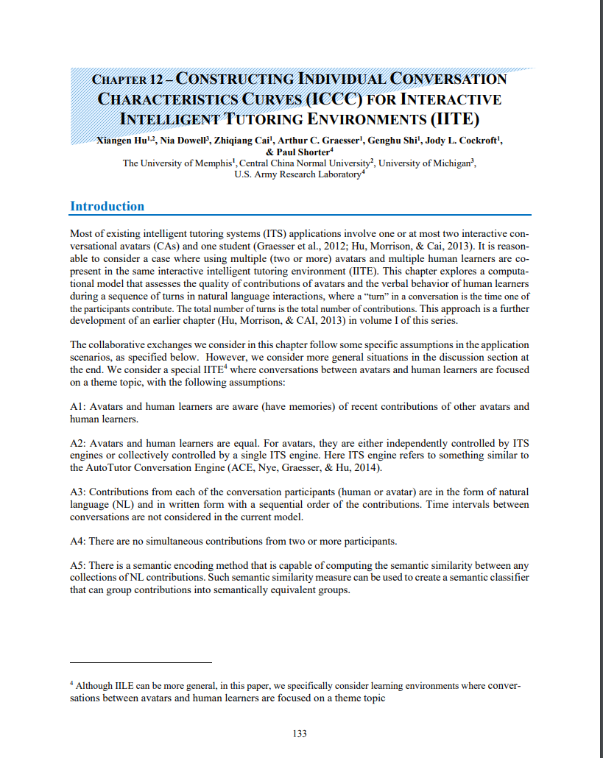

Slide 5
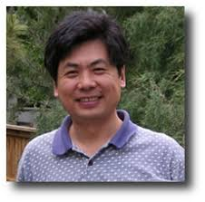
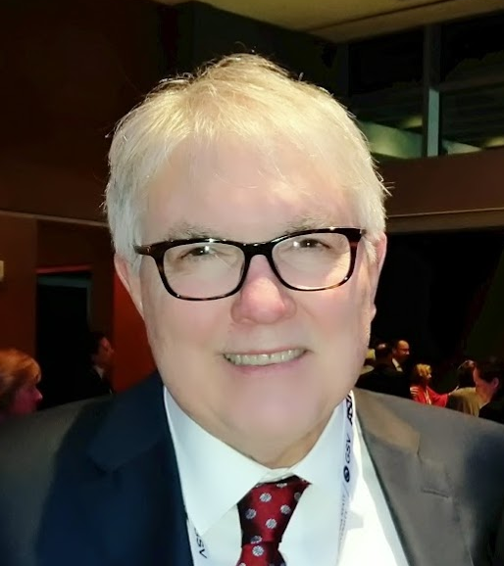
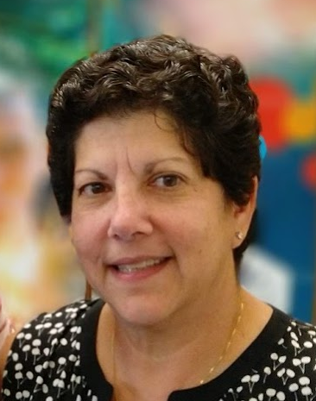
Paul Short

Slide 6
Outline
Background
Group Communication Analysis (GCA)
Individual Conversation Characteristics Curves (ICCC)
Semantic Representation & Analysis (SRA) for ICCC
Model of Participants using ICCC
Potential applications
Summary / Questions

Slide 7
Background

Slide 8
Background

Slide 9
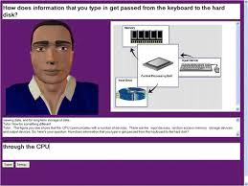
Background

Slide 10
Background

Slide 11
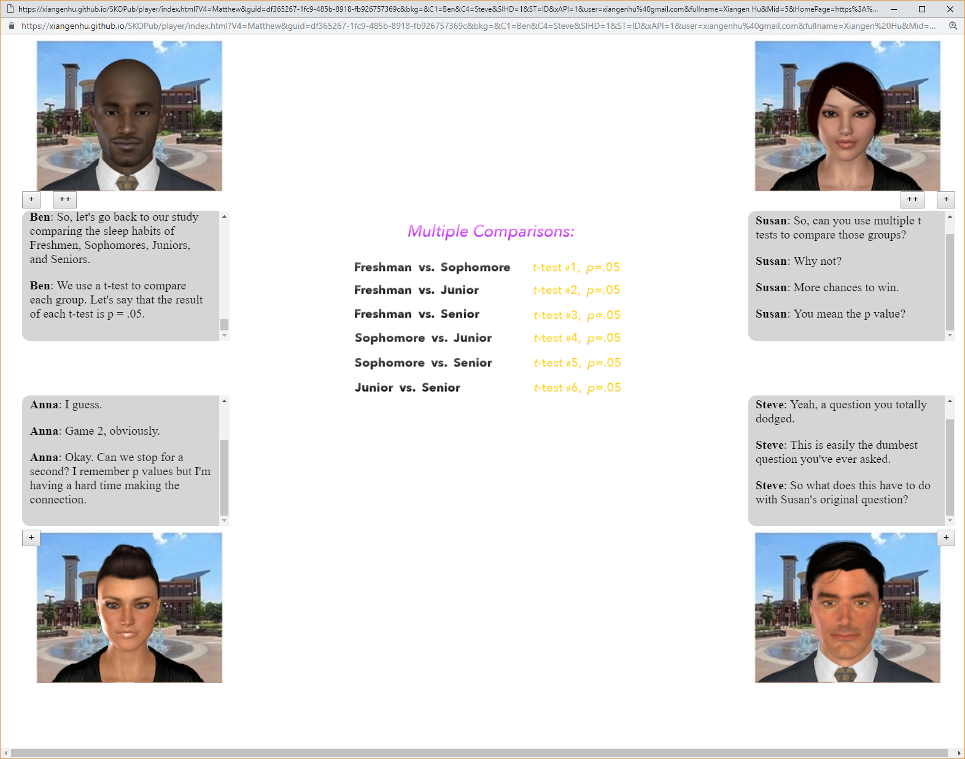
Background

Slide 12
background
Group discussions/teamwork
a non-monitored/non-moderated group discussions would not reach the desired goal and hence waste of time of the participants.

Slide 13
background
Group discussions/teamwork
With the presence of monitor/moderator discussions may be focused to achieve a desirable outcome.

Slide 14
background
Group discussions/teamwork
Can monitoring/moderating of discussions be automated (handled by intelligent monitoring/moderating systems)?
If yes, How?

Slide 15
Group Communication Analysis (GCA)

Slide 16
Group Communication Analysis (GCA)
Basic Assumptions
A1: Avatars and human learners are aware (have memories) of recent contributions of other avatars and human learners.

Slide 17
Group Communication Analysis (GCA)
Basic Assumptions
A2: Avatars and human learners are equal.
For avatars, they are either independently controlled by ITS engines or collectively controlled by a single ITS engine. Here ITS engine refers to something similar to the AutoTutor Conversation Engine (ACE, Nye, Graesser, & Hu, 2014).

Slide 18
Group Communication Analysis (GCA)
Basic Assumptions
A3: Contributions from each of the conversation participants (human or avatar) are in the form of natural language (NL) and in written form with a sequential order of the contributions. Time intervals between conversations are not considered in the current model.

Slide 19
Group Communication Analysis (GCA)
Basic Assumptions
A4: There are no simultaneous contributions from two or more participants.

Slide 20
Group Communication Analysis (GCA)
Basic Assumptions
A5: There is a semantic encoding method that is capable of computing the semantic similarity between any collection of NL contributions.
Such semantic similarity measure can be used to create a semantic classifier that can group contributions into semantically equivalent groups.

Slide 21
Group Communication Analysis (GCA)
GCA Measures
Participation
Overall Responsivity
Internal Cohesion
Social Impact
Newness
Communication Density

Slide 22
Individual Conversation Characteristics Curves (ICCC)

Slide 23
Individual Conversation Characteristics Curves (ICCC)
Data from group discussions

Slide 24
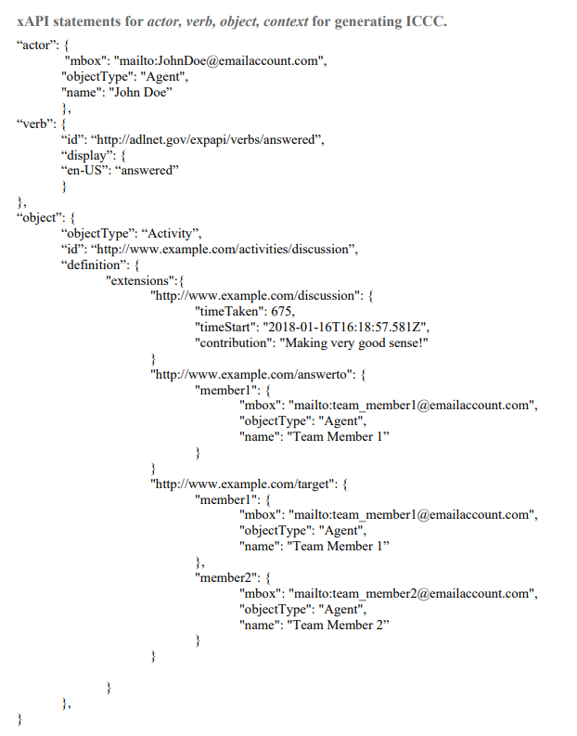
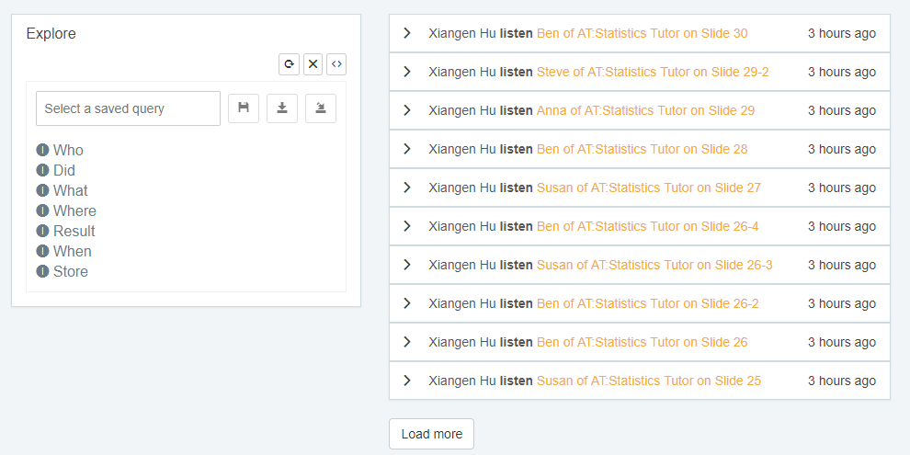
Individual Conversation Characteristics Curves (ICCC)
Data from group discussions
xAPI Statement

Slide 25
Individual Conversation Characteristics Curves (ICCC)
Data from group discussions
xAPI Statement

Slide 26
Individual Conversation Characteristics Curves (ICCC)
Data from group discussions
actor is a unique identifier for the participant (avatars or humans).
verb is a collection of speech act classifiers such as “answered”, “asked”, etc. They are a small subset of xAPI vocabulary (http://xapi.vocab.pub/verbs/index.html).
object would be the contribution of the actor, in natural language, and
target of the contribution, which is a subset of all participating avatars and human.

Slide 27
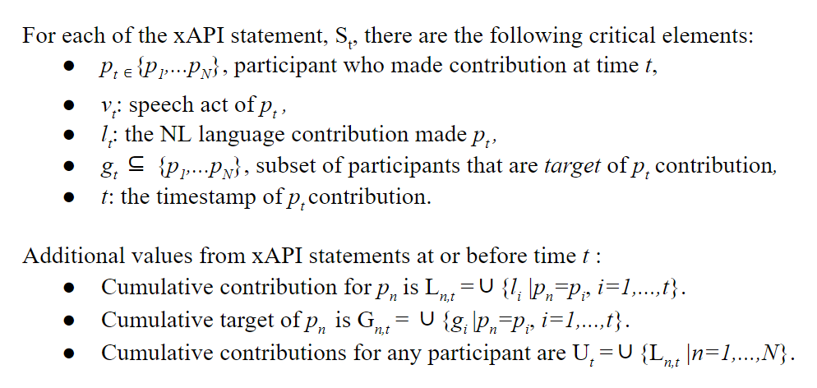
Individual Conversation Characteristics Curves (ICCC)
Data from group discussions
actor is a unique identifier for the participant (avatars or humans).
verb is a collection of speech act classifiers such as “answered”, “asked”, etc. They are a small subset of xAPI vocabulary (http://xapi.vocab.pub/verbs/index.html).
object would be the contribution of the actor, in natural language, and
target of the contribution, which is a subset of all participating avatars and human.

Slide 28
Individual Conversation Characteristics Curves (ICCC)
GCA Measures
Participation
Overall Responsivity
Internal Cohesion
Social Impact
Newness
Communication Density

Slide 29
Individual Conversation Characteristics Curves (ICCC)
GCA Measures
Participation
Overall Responsivity
Internal Cohesion
Social Impact
Newness
Communication Density

Slide 30
Semantic Representation & Analysis (SRA) for ICCC

Slide 31
SRA for ICCC
Semantic Representation & Analysis
(SRA)
Basic Assumptions
A1: …….
A2: …….
A3: NL participation
A4: …….
A5: Semantic Encoding/Decoding Technology

Slide 32
SRA for ICCC
Basic Assumption of SRA
Unified semantic representation --- Vector form for semantic representation
Similarity measure with each vector-based model

Slide 33
SRA for ICCC
Basic Assumption of SRA
Hierarchical:
Semantics of different levels of a language entity may be represented differently.
Algebraic:
The semantics of any level of language entities must be capable of being represented numerically or algebraically.
Computational:
The semantic representations of a higher-level language entity are computed as a function of semantic representations for its lower-level language entities.
At the lowest level of language entities, a numerical semantic comparison measure must exist between any two items (e.g., words).

Slide 34
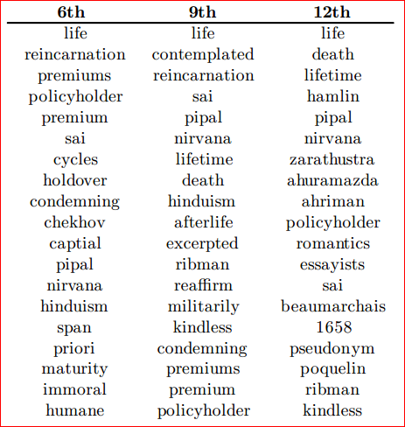
SRA for ICCC
Induced Semantic Structure

Slide 35
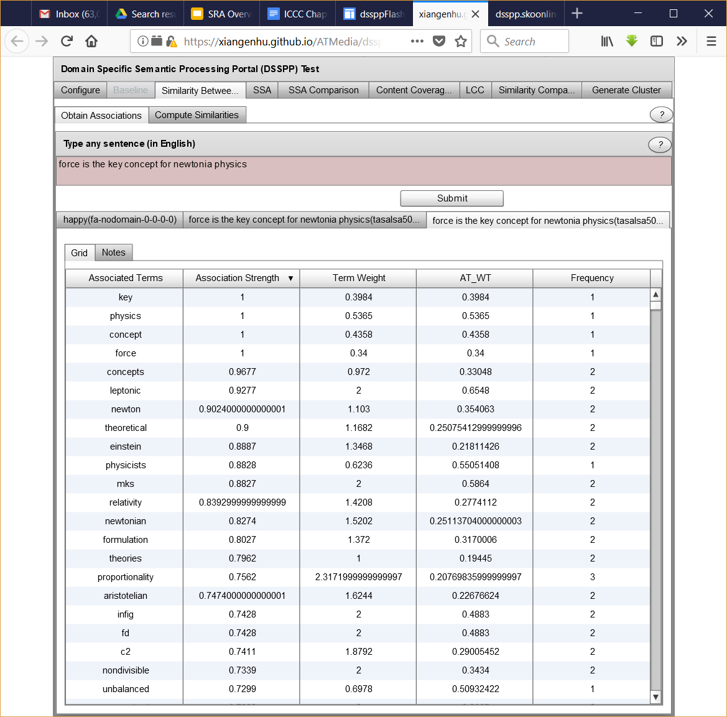
SRA for ICCC
Induced Semantic Structure

Slide 36
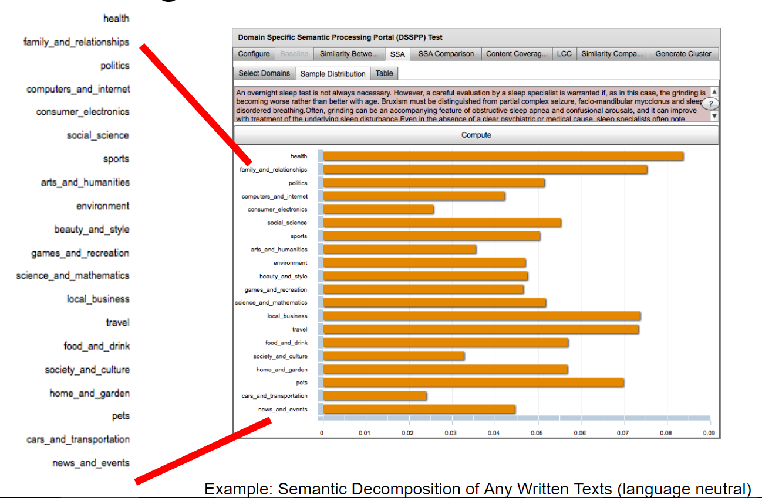
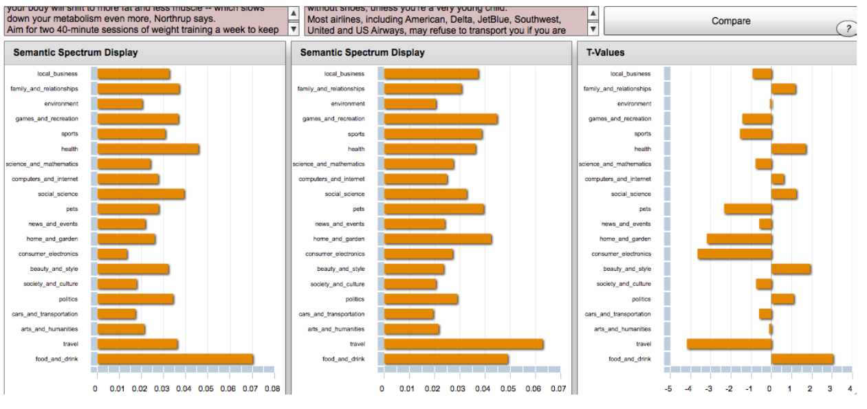
SRA for ICCC
Induced Semantic Structure

Slide 37
Model of Participants using ICCC

Slide 38
Model of Participants using ICCC
GCA Measures for all participants
Participation
Overall Responsivity
Internal Cohesion
Social Impact
Newness
Communication Density

Slide 39
Potential applications

Slide 40
Potential applications
Optimal dialog in Multi Avatar/Team Tutoring Systems

Slide 41
Potential applications
Optimize Team Training Efficiency

Slide 42
Potential applications
Regulate Group Behavior

Slide 43
ICCC automated intelligent monitoring/moderating systems

