Slide 1
The FACT classroom orchestration system: Helping teachers effectively enact individual, small-group and whole-class activities
Kurt VanLehn
School of Computing, Informatics and Decision Systems Engineering Arizona State University

Slide 2
FACT (Formative Assessment with Computational Technology)
ASU team
Math Assessment Project Nottingham, Berkeley & SVMI
Salman Cheema (Analysis team leader)
Jon Wetzel (Media team leader)
10 MS CS students
Hugh Burkhardt
Alan Schoenfeld
The late Malcolm Swan
Daniel Pead
David Foster

Slide 3
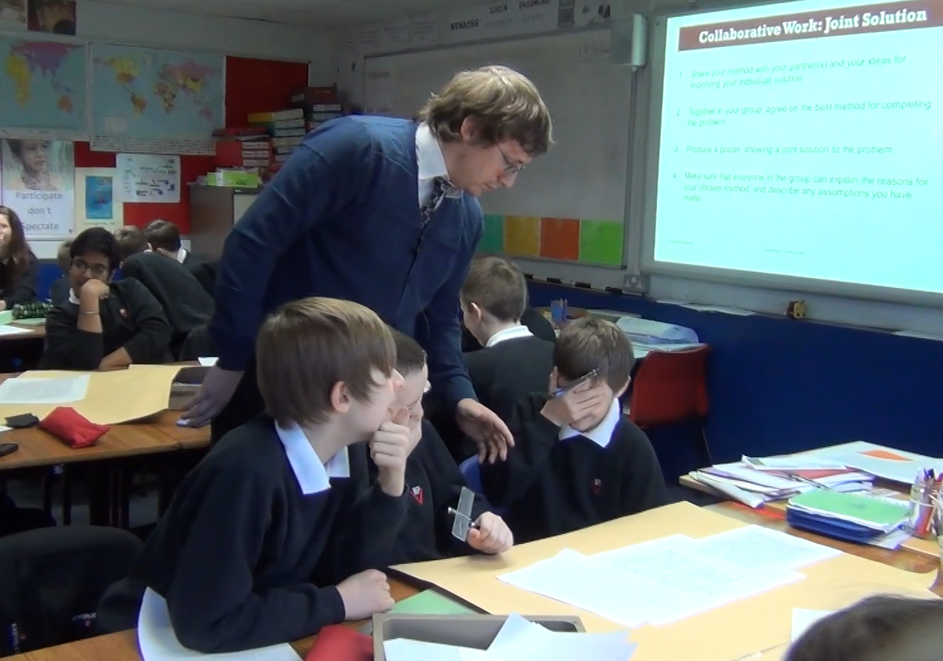
Can a orchestration system help a class that is doing a Classroom Challenge?

Slide 4
Outline
Next
Orchestration systems
Classroom Challenges
Productive struggle
The FACT media system
Description
Evaluation
The FACT analysis system
Description
Evaluation
Future work

Slide 5
*Definitions:
Orchestration refers to the teacher’s management of a lesson that integrates small-group, individual and whole-class activities.
An orchestration system is a computer system that helps the teacher and students with orchestration.
* Dillenbourg, P. (2013). Design for classroom orchestration. Computers & Education, 69, 485-492.

Slide 6
Orchestration systems developed from 3 roots
Classroom management systems (CMS)
Pause class
View student screens
Project a student’s screens
View help request queue
Device alerts e.g., low battery
Project a document
Send/get files & messages
Polling (like clickers)
Security features

Slide 7
Orchestration systems developed from 3 roots
Classroom management systems (CMS)
View student screens
Pause class
Projecting student screens
Computer-supported collaborative learning (CSCL)
Monitoring group participation
Group membership
Complex lesson plans e.g., jigsaw, think-pair-share
Next activity
Timing
Modify lesson plan during class

Slide 8
Orchestration systems developed from 3 roots
Classroom management systems (CMS)
View student screens
Pause class
Projecting student screens
Computer-supported collaborative learning (CSCL)
Monitoring group participation
Complex lesson plans e.g., jigsaw, think-pair-share
Intelligent tutoring systems (ITS)
Monitor students’ performance when doing an activity
Compare to expected performance
Can give feedback and hints

Slide 9
There are 4 clusters of orchestration systems
 | CMS features | CSCL features | ITS features
Commercial CMS E.g., LanSchool, Netop Vision, Netsupport | Yes
Adding dashboard to CSCL system E.g., Group Scribbles, Frog, Saglet, NumberNet | Yes | Yes
Adding dashboard to an ITS E.g., Lumilo, Snappet | Yes |  | Yes
“Full” orchestration system E.g., FACT, MTFeedback, Argunaut, | Yes | Yes | Yes

Slide 10
Outline
Orchestration systems
The Classroom Challenges
Productive Struggle
The FACT media system
Description
Evaluation
The FACT analysis system
Description
Evaluation
Future work
Next

Slide 11
What are the Classroom Challenges?
Developed over 10 years by the Mathematics Assessment Project
Alan Schoenfeld, Hugh Burkhardt, Malcom Swan, David Foster and many others
Approximately 100 available; grades 6 through 10
In a large study, 4.6 month advantage over baseline
Widely used: 7M+ downloads
Often used for professional development
Few publications, so go to map.mathshell.org

Slide 12
The Classroom Challenges employ an unusual instruction
Students co-construct correct mathematical concepts and solutions without feedback or explanations from the teacher, textbooks, technology or any other source.
Black & Wiliam* called it formative assessment
But that term has many other meanings as well
MAP has started to use a new term:
Collaborative Productive Struggle
* Black, P., & Wiliam, D. (1998). Assessment and classroom learning. Assessment in Education: Principles, Policy and Practice, 5(1), 7-75.

Slide 13
Three types of instruction
Model-Scaffold-Fade
Productive failure
Productive struggle
Teacher explains & demos correct
Students practice while teacher corrects errors
Students keep trying despite failures. Teacher does not correct errors.
Teacher explains & demos correct
Students keep trying despite failures. Teacher does not correct errors.
The Classroom Challenges
Swan, M., & Burkhardt, H. (2014). Lesson design for formative assessment. Educational Designer: Journal of the International Society for Design and Development in Education, 2(7).
Manu Kapur, Nikol Rummel,
Dan Schwartz & others
Traditional
Loibl, K., Roll, I., & Rummel, N. (2017). Towards a theory of when and how problem solving followed by instruction supports learning. Educational Psychological Review, 29(4), 693-715.
Map.mathshell.org

Slide 14
Example: Here is model-scaffold-fade method of teaching a 6th grade math concept
From $160 to $200 is …
an increase of 20%
an increase of 25%
an increase of 40%
Teacher explains the concept procedurally:
Take the absolute difference between the first number and the second. What percentage of the first number is that difference?
From $200 to $160 is …
a decrease of 20%
a decrease of 25%
a decrease of 40%

Slide 15
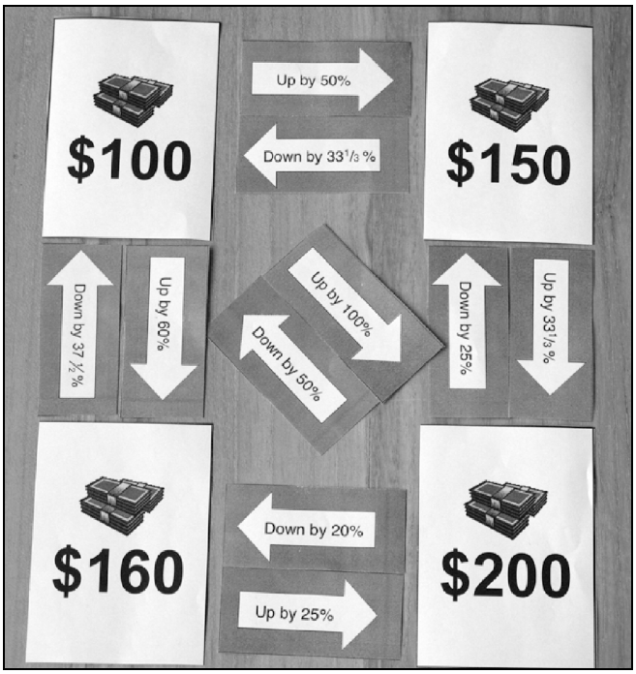
Teaching with Productive Failure
Give students a difficult, long problem that they will probably not solve.
Then conclude with model-scaffold-fade
Start
Arrow card
Correct placements

Slide 16
Teaching with Productive Struggle
Working first individually, then in small groups and then as a whole class, students figure out where to place 10 arrow cards.
Start
Arrow card
Correct placements

Slide 17
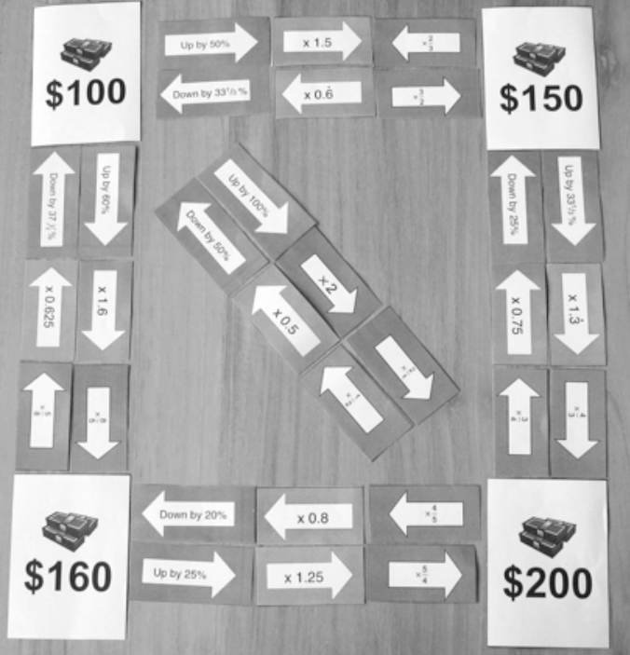
Productive struggle, continued
First place percentages
Then place decimals
Finally place fractions
$200 x 4/5 = $160
$160 x 5/4 = $200

Slide 18
This Classroom Challenge has many phases over about one or two hours
Pre-assessment (day before main lesson)
Teacher analyzes every student’s work (overnight)
Phase 1: Percentage arrow cards are placed
Small groups; Teacher circulates, occasionally showing a group’s work to the whole class
Sharing: one student from each group visits another group
Phase 2: Decimals arrow cards are placed
Phase 3: Fraction arrow cards are placed
Phase 4: Whole class discussion
Post-assessment

Slide 19
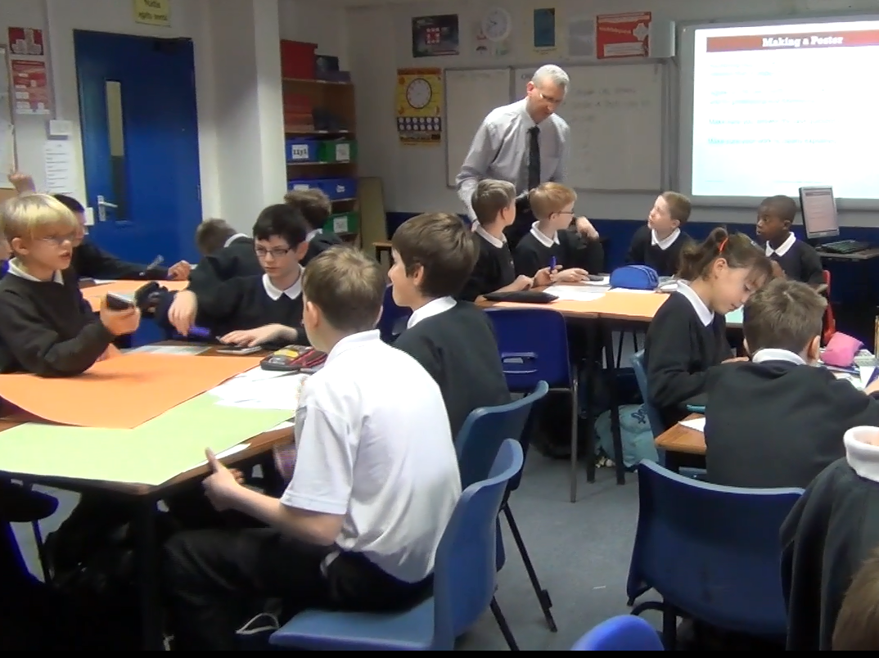

Slide 20
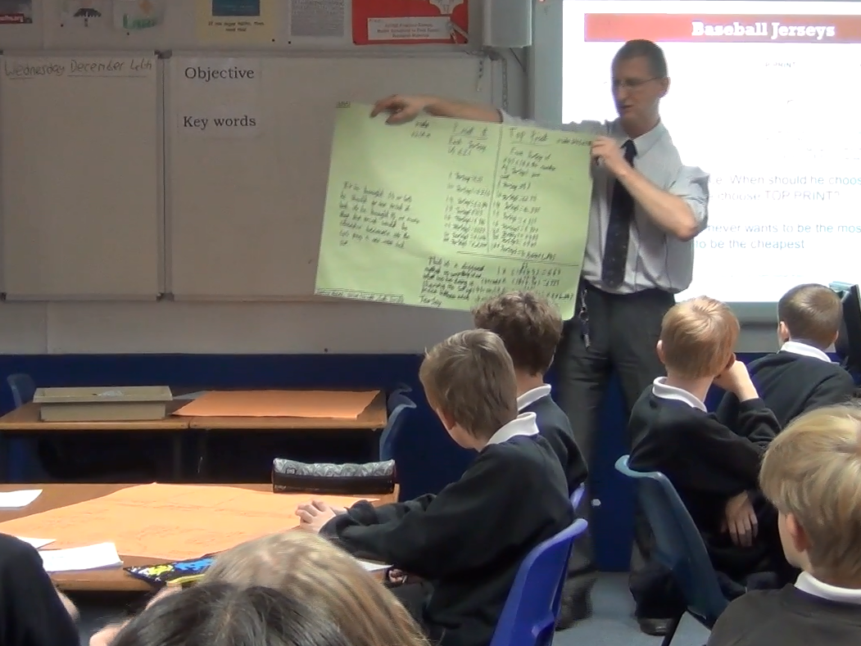

Slide 21
Why should students succeed at finding the correct concepts?
Task and materials provide implicit feedback and hints
When student share their thinking, then from diverse prior ideas, the fittest ideas emerge
Individual work →
Small group work →
Whole class work
Teacher’s role
Encourage explanation & co-construction
Encourage persistence
Never correct nor explain

Slide 22
Theoretical benefits of Projective Struggle over Productive Failure
Many students and teachers believe that…
Math is created only by mathematicians.
Learning math = correctly understanding the mathematicians, and then memorization via copious practice.
Teachers role is to explain the mathematicians clearly, and then supervise the practice
Productive Struggle demonstrates that these beliefs are false.
Students can create math

Slide 23
An evaluation of the Classroom Challenges (mentioned earlier)
Methods
Algebra I, Kentucky
Approximately 6 Classroom Challenges during the year
Approximately 1.5 days of PD for teachers
2,690 students; 56 teachers
Constructed baseline
Standardized state-wide test
Results*
Effect size equivalent to 4.6 months of additional schooling
* Herman, J., La Torre Matrundola, D., Epstein, S., Leon, S., Dai, Y., Reber, S., & Choi, K. (2015). The implementation and effects of the Mathematics Design Collaborative (MDC): Early findings from Kentucky ninth-grade algebra 1 courses (CRESST Report 845). UCLA, Los Angeles, CA.

Slide 24
Why did such a short exposure cause such a large effect?
Teacher interviews*
Big change in their beliefs about math
Changed how they teach all their math lessons
Classroom Challenges succeed as professional development
* http://inverness-research.org/mars_map/1_welcome.html

Slide 25
But there is room for improvement
Student interviews*
Moderate change in their beliefs about math
Student learning of math concepts**
Low scores on experimenter-designed tests
Pre-assessments ≈ post-assessments
* http://inverness-research.org/mars_map/1_welcome.html
** Herman et al., op. cit.

Slide 26
Interpretation
During the Classroom Challenges, only a few students successfully created the target math
So only a few students
Changed their beliefs
Learned the target concepts
Because the teachers expected no student to succeed, even a few successes
Caused teachers to change their beliefs
And their teaching
Which caused large gains over the year

Slide 27
What should we do?
We could convert to Productive Failure
Add Model-Scaffold-Fade phase at end
That would improve student math learning
But it would fail to convince teachers and students that students can create math
We can try to increase the number of students who succeed in creating the target math
Without destroying the Productive Struggle experience?
This is the goal of the FACT project

Slide 28
FACT has two components
The FACT Media System
CSCL system + dashboard
Helps teachers manage workflow
The FACT Analysis System
A “full” orchestration system
Analyzes student work in real-time
Alerts teacher to opportunities for intervention

Slide 29
Outline
Orchestration systems
The Classroom Challenges
Productive struggle
The FACT media system
Description
Evaluation
The FACT analysis system
Description
Evaluation
Future work
Next

Slide 30
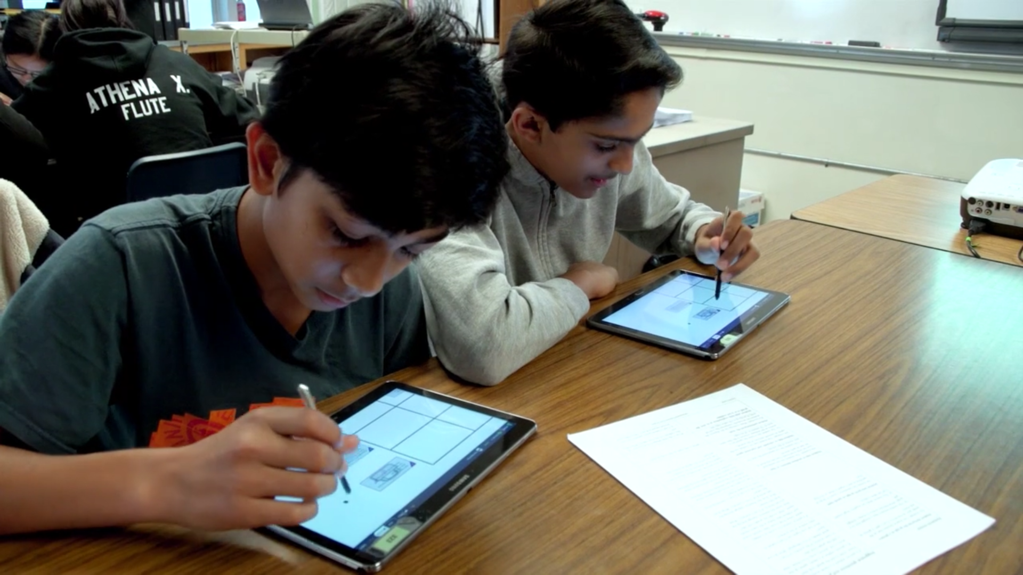
Every student has their own tablet even when working in group

Slide 31
Circulating with tablet in hand

Slide 32
Helping students re-engage

Slide 33
FACT Student interface
Can add more cards
Moveable
cards.
Posterboard, which can have
a background graphic

Slide 34
Student interface
Zoom (or pinch)
Zoom (or pinch)
Scroll
Scroll

Slide 35
Student interface
Can tell teacher when done
Can type
Can type
Can draw
with finger,
stylus or
mouse
Can draw
with finger,
stylus or
mouse

Slide 36
Teacher’s dashboard
One rectangle
per student
Batman & Robin
are in group 1
Group 2’s progress
FACT’s heartbeat has stopped

Slide 37
Smooth workflow
Choose one of 8 Classroom Challenges
Pausing the class.
Student apps show
“Eyes on teacher”
Project the teacher’s
screen on the classroom
projector or Smartboard
Choose an activity or just go to next
Choose an activity or just go to next
Launch & other posters available only to teacher
Student’s log in by entering their name and the class code

Slide 38
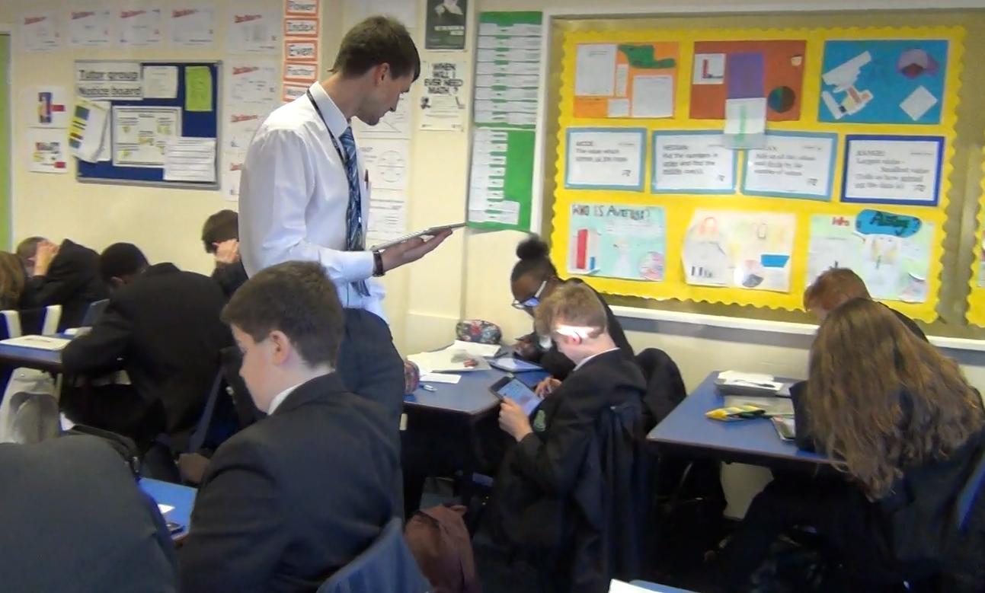
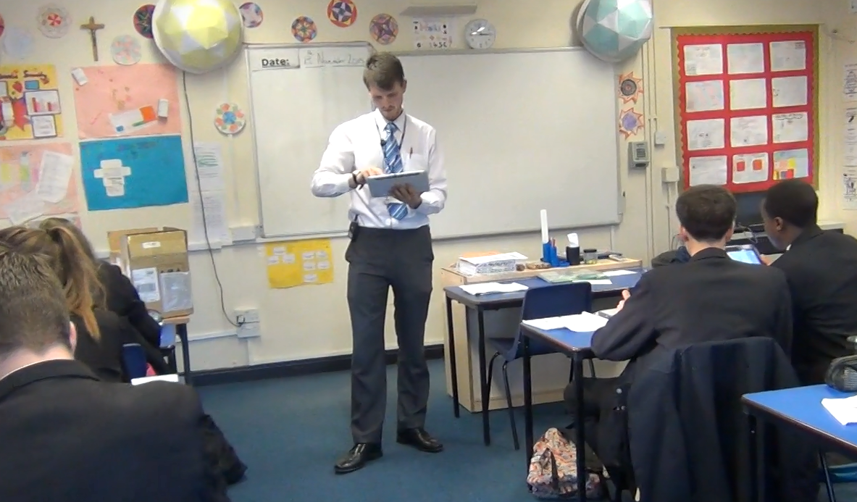
Evaluations compare the FACT media system to paper-based
Paper
VS
FACT

Slide 39
Analyses of 3-camera synched videos

Slide 40
Usability*
Teacher often talking with tech support
 | Time Wasted |  | Time Off-Task
 | Avg. Time | Avg. Ratio per lesson | Avg. Time | Avg. Ratio per lesson
FACT | 3:23 | 5.79% | 3:40 | 5.66%
Paper | 7:07 | 10.42% | 1:49 | 2.85%
FACT wasted time
Paper wasted time
Logging in (1:06)
Joining groups (0:56)
Software glitches (0:44)
Manipulating material without discussing math (5:45)
Waiting for paper to be distributed (0:35)
Searching for lost cards (0:48)
* Wetzel, J., Burkhardt, H., Cheema, S., Kang, S., Pead, D., Schoenfeld, A. H., & VanLehn, K. (2018). A preliminary evaluation of the usability of an AI-infused orchestration system. In C. Rosé, R. Martínez-Maldonado, U. Hoppe, R. Luckin, M. Mavrikis, K. Porayska-Pomsta, B. McLaren, & B. du Boulay (Eds.), Artificial Intelligence in Education: Proceedings of the 19th International Conference (pp. 378-383). Berlin: Springer.

Slide 41
ICAP coding for collaboration*
Distributions not reliably different (χ² p=0.3, N=59)
FACT did not harm collaboration (or help it)
Need to elicit more explanation & co-construction
* VanLehn, K., Burkhardt, H., Cheema, S., Kang, S., Pead, D., Schoenfeld, A. H., & Wetzel, J. (2018). The effect of digital versus traditional orchestration on collaboration in small groups. In C. Rosé, R. Martínez-Maldonado, U. Hoppe, R. Luckin, M. Mavrikis, K. Porayska-Pomsta, B. McLaren, & B. du Boulay (Eds.), Artificial Intelligence in Education: Proceedings of the 19th International Conference (pp. 369-373). Berlin: Springer.

Slide 42
Productive Struggle
 | FACT pairs (N=18) | Paper pairs (N=6)
Struggling productively | 7 | 5
Struggling unproductively | 7 | 1
Not struggling enough | 4 | 0
Distributions are not reliably different
Chi-square, p=0.15
Low power
FACT needs to help students succeed as they struggle

Slide 43
Outline
Background on orchestration systems
How to improve the Classroom Challenges?
The FACT media system
Description
Evaluation
The FACT analysis system
Description
Evaluation
Future work
Next

Slide 44
Increasing awareness
Most common issue. Consider pausing class to discuss it
FACT recommends visiting or peeking at group 2

Slide 45
Teacher is peeking at Catwoman’s view of Group 2’s poster
FACT recommends attending to these two regions
FACT recommends attending to these two regions
Tap or click here to find out more

Slide 46
Teacher tapped/clicked on a red button and is viewing an alert
Can browse alerts
Sends the prompt to the group
If teacher doesn’t like FACT’s recommendation
Resume peeking

Slide 47
A major technical challenge: Understanding students’ work

Slide 51
How FACT analyzes students’ work
For card arrangements
Currently, one recognizer per possible card pairing
For hand writing
Input from tablets is strokes
Heuristic segmentation
MyScript converts segments to text & simple math
For text, keywords
For math, search for derivations
Validation
Compare to experts’ annotations
Forthcoming

Slide 52
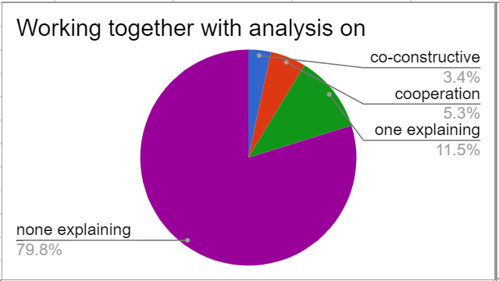
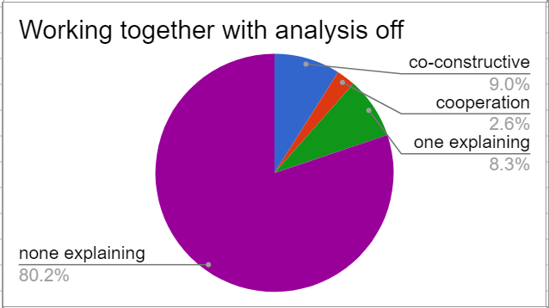
Collaboration
Distributions are not reliably different
Chi-square, p=0.94, N=7 per condition
Low power
Still not enough explanation and co-construction

Slide 53
Productive struggle
 | Analysis On (N=7) | Analysis Off (N=7)
Struggling productively | 7 | 3
Struggling unproductively | 0 | 6
Not struggling enough | 0 | 1
Distributions were reliably different
Chi-square, p=0.004
The FACT analysis system appears to have increased student success rate

Slide 54
Summary of evaluations
Productive struggle
FACT Analysis > FACT media = Paper
Collaboration
FACT Analysis = FACT media = Paper
Usability
FACT media = Paper

Slide 55
Outline
Orchestration systems
The Classroom Challenges
Productive Struggle
The FACT media system
Description
Evaluation
The FACT analysis system
Description
Evaluation
Future work
Next

Slide 56
Near term future work: Add process awareness
In lab studies, high accuracy collaboration detection
Actions alone: Kappa = 0.78
Speech/silence alone: Kappa = 0.82
Both actions and speech: Kappa = 0.79
But amount of collaboration was high (30%)
Initial trials in classrooms failed
Too often reported non-collaboration?
Other processes need to be detected, too

Slide 57
Long term future work: Automated teaching assistant
Detecting issues will soon no longer be the bottleneck
Taking action is will become the new bottleneck
But there is only one teacher
How can FACT have more autonomy to act
But still do only what the teacher wants it to do?
How can the teacher trust it?
Understanding speech is still a major technical challenge

Slide 58
Summary
The Classroom Challenges are
Highly successful as professional development
But students are neither collaborating nor struggling productively enough
The current version of FACT
Successful as an orchestration system
Improves productivity
Does not improve collaboration
The next version of FACT
Will sense more of classroom processes
Will send more advice directly to students

Slide 59
谢谢
The Classroom Challenges are
Highly successful as professional development
But students are neither collaborating nor struggling productively enough
The current version of FACT
Successful as an orchestration system
Improves productivity
Does not improve collaboration
The next version of FACT
Will sense more of classroom processes
Will send more advice directly to students

