Slide 1
Coh-Metrix:
A tool for analyzing text and discourse
Zhiqiang Cai & Xiangen Hu

Slide 2
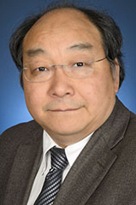
Zhiqiang Cai
Xiangen Hu

Slide 3
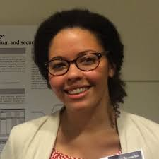
Danielle McNamara
Art Graesser
Max Louwerse
Phil McCarthy
Haiying Li
Nia Dowell

Slide 4
Overview
Introduction to Text and Discourse Analysis
Coh-Metrix tool walk through
Break
Indices in Coh-Metrix

Slide 5
Overview
Introduction to Text and Discourse Analysis
Coh-Metrix tool walk through
Break
Indices in Coh-Metrix

Slide 6
An Exclamation Mark from Nature
《驚嘆號》
雲寧似水水如雲，
長嘆聲來驚世人。
天地無言任顛倒，
等閑誰看日西沉。
Notes:
Use this poem to demonstrate the process of text analysis. Emphasize how text is related to world.

Slide 7
A Man Watching Sunset
《看夕阳》
等閑誰看日西沉，雲似平湖水似雲。
天地循環朝到暮，幾多世事可由人？
文
我
物
分析 》联系

Slide 8
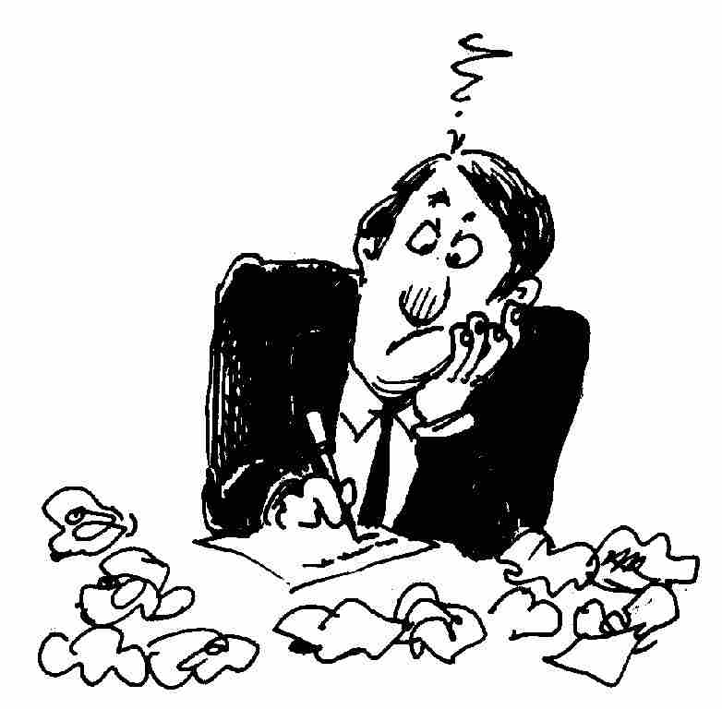
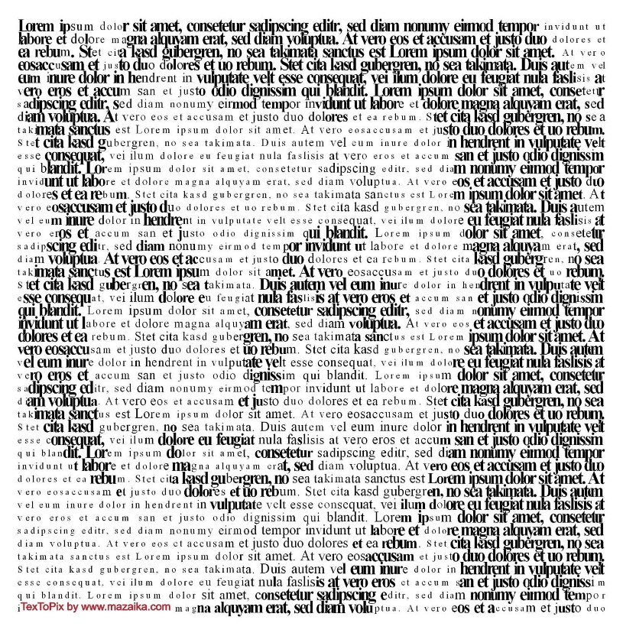
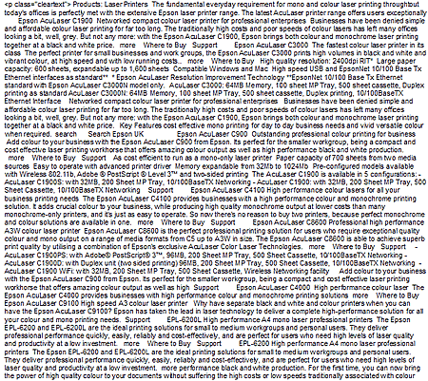
From Text to Discourse

Slide 9
Text Analysis vs Discourse Analysis
Discourse analysis
Associate text features with persons
Reveal socio-psychological characteristics
Example: Coherence
Text analysis
Extract text features
Reveal text structure
Example: Cohesion

Slide 10
Process of Text and Discourse Analysis
断句
《驚嘆號》
雲寧似水水如雲，
長嘆聲來驚世人。
天地無言任顛倒，
等閑誰看日西沉。
分词
释词
释句
释篇

Slide 11
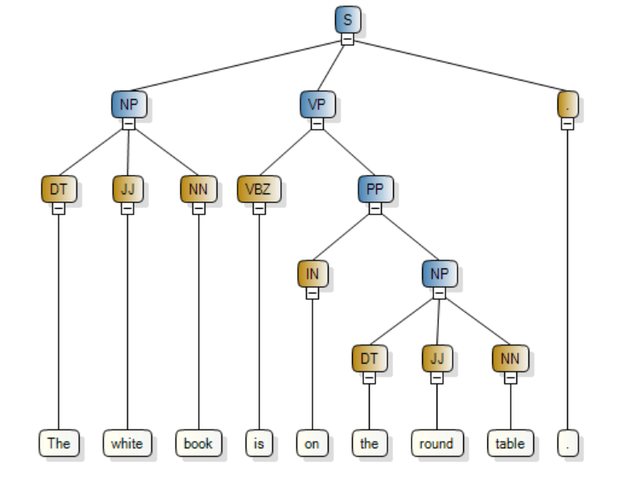
Parse Tree

Slide 12
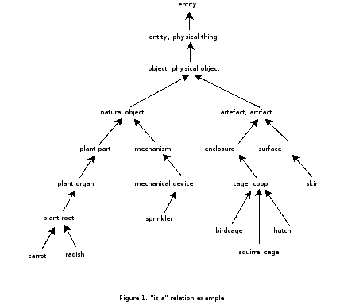
Indices: Word Information(IV)
WordNet freatures
Abstract
Concrete

Slide 13
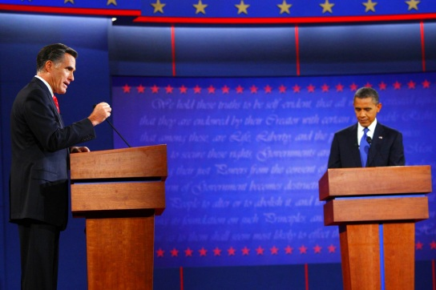
语篇分析实例：美国总统大选辩论

Slide 14
语篇分析实例：政治家语言连贯性的变化

Slide 15
Maps and Globes vs. How the Camel Got His Hump Back (CC Grades 2-3, FK 6-7, 950/910 Lexile)
Thousands of years ago, our ancestors invented the map.
Ancient maps were crude but very useful tools. They helped people find food, clean water, and the way back home--even when home was a cave.
As civilizations grew, better maps were needed.
Now this is the next tale, and it tells how the Camel got his big hump. In the beginning of years, when the world was so new and all, and the Animals were just beginning to work for Man, there was a Camel, and he lived in the middle of a Howling Desert…

Slide 16
Overview
Introduction to Text and Discourse Analysis
Coh-Metrix tool walk through
Break
Indices in Coh-Metrix

Slide 17
Coh-Metrix Tool Walk Through
Thanks to
Bibing Shi (史碧冰)

Slide 18
Tool Download
English
http://141.225.41.245/download/cohmetrix2018.zip
Chinese
http://141.225.41.245/download/
cohmetrixcn_release_2018_09_16.zip

Slide 19
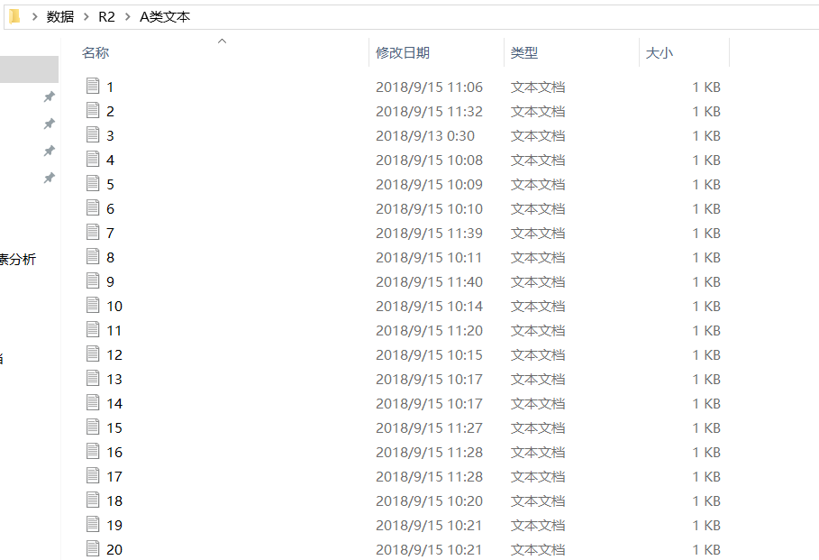
1. ：将需要在Coh-Metrix软件上分析的文本，逐篇保存为txt.格式，统一放在某一个文件，如A类文本。

Slide 20
2.下载Coh-Metrix 3 单机版
下载地址：http://141.225.41.245/download/cohmetrix2018.zip ；
3. 解压后，点击打开Release 文件夹；

Slide 21
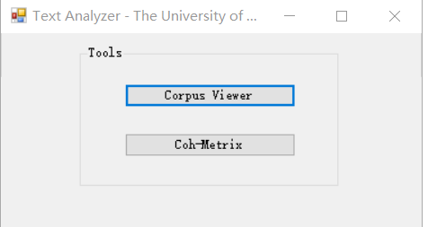
4. Release 文件夹中找到应用程序Coh-Metrix 3，点击出现Text Analyzer 对话框；

Slide 22
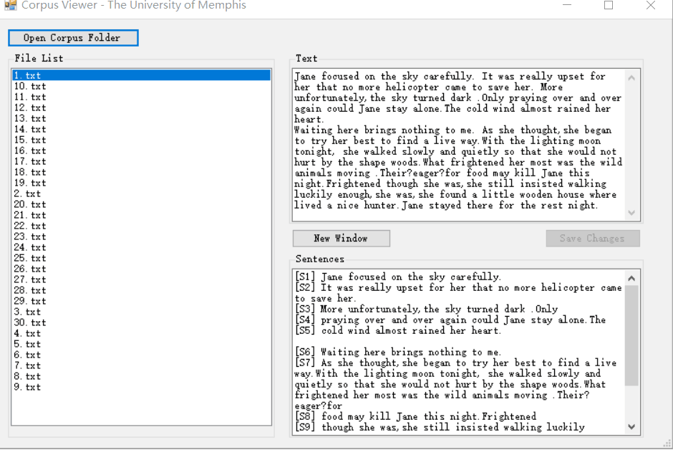
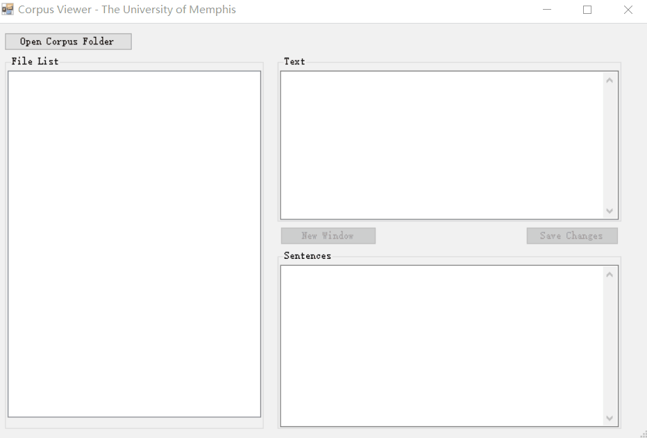
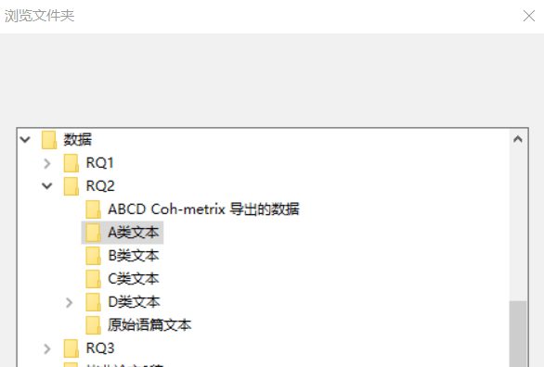
5. 导入文本预处理
点击Corpus Viewer
点击 Open Corpus Folder，导入所要分析的文本文件夹，如A类文本
导入成功后（如右图），在Text框可看到相应原始文本。
研究者可在Text框或New Window 中检查导入的文本是否存在问题，比如出现不能识别的字符，或者超长的不合语法的句子等等；并可根据研究实际，在上面稍作修改，以保证后期文本的顺利分析；
如作了修改，需点击Save change保存。

Slide 23
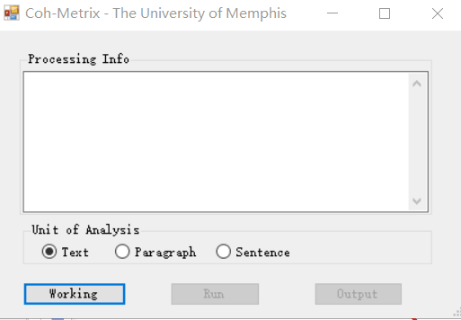
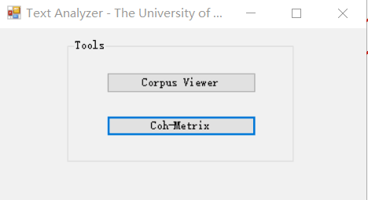
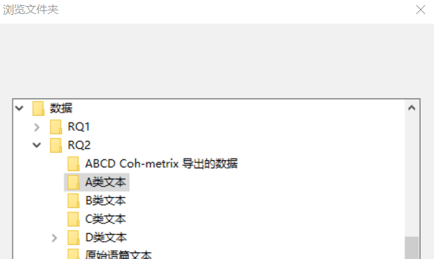
6. 文本分析：Coh-Metrix
点击Coh-Metrix
点击Working，打开所要分析的文本文件夹，如A类文本文件夹；

Slide 24
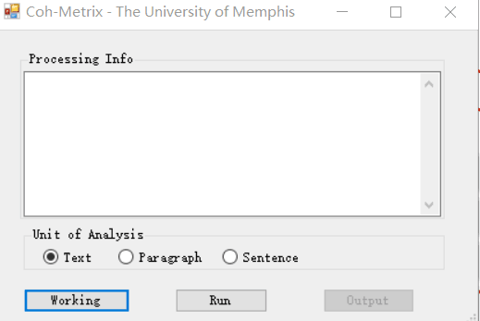
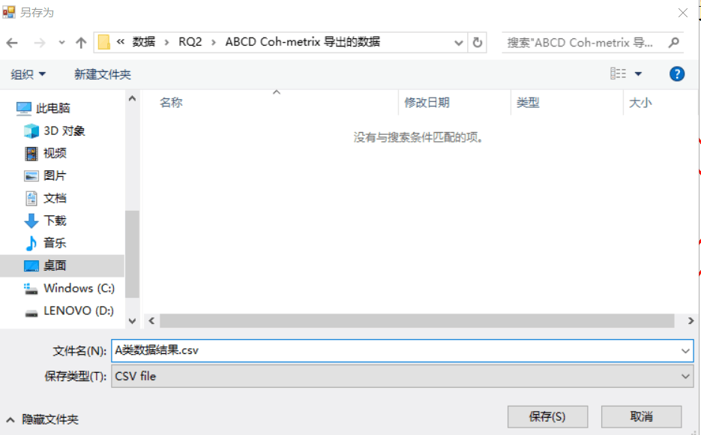
6. 文本分析：Coh-Metrix
点击Coh-Metrix
点击Working，打开所要分析的文本文件夹，如A类文本文件夹；
根据研究实际，选择分析Unit 类型；
点击Run，在弹出的对话框自定义分析后的数据结果所要保存的位置并命名文件夹，如A类数据结果，点击保存(S)后， Coh-Metrix便开始自动分析。

Slide 25
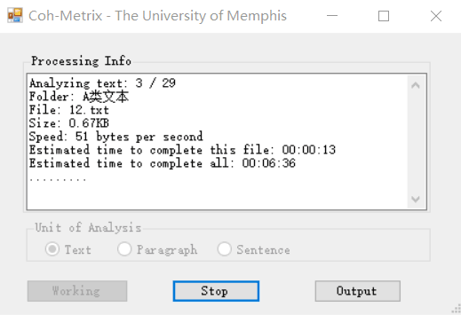
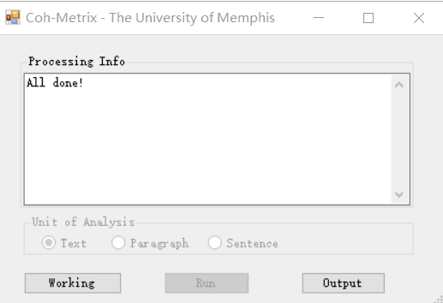
6. 文本分析：Coh-Metrix
点击Coh-Metrix
点击Working，打开所要分析的文本文件夹，如A类文本文件夹；
根据研究实际，选择分析Unit 类型；
点击Run，在弹出的对话框自定义分析后的数据结果所要保存的位置并命名文件夹，如A类数据结果，点击保存(S)后， Coh-Metrix便开始自动分析。
点击Stop，可中途暂停分析
结束分析后，点击Output可直接查看数据结果（Excel）或从自定义的数据结果文件夹查看。

Slide 27
Overview
Introduction to Text and Discourse Analysis
Coh-Metrix tool walk through
Break
Indices in Coh-Metrix

Slide 29
Indices in Coh-Metrix

Slide 30
Indices: Descriptives
1 DESPC Paragraph count, number of paragraphs
2 DESSC Sentence count, number of sentences
3 DESWC Word count, number of words
4(5) DESPL(d) Paragraph length, number of sentences(std)
6(7) DESSL(d) Sentence length, number of words(std)
8(9) DESWLsy(d) Word length, number of syllables(std)
10(11) DESWLlt(d) Word length, number of letters (std)
Short discussion: Why STD?

Slide 31
Indices: Connectives
52 CNCAll All connectives
53 CNCCaus Causal connectives
54 CNCLogic Logical connectives
55 CNCADC Adversative and contrastive incidence
56 CNCTemp Temporal connectives incidence
57 CNCTempx Expanded temporal connectives
58 CNCAdd Additive connectives
59 CNCPos Positive connectives
CNCNeg Negative connectives
(Incidence scores)

Slide 32
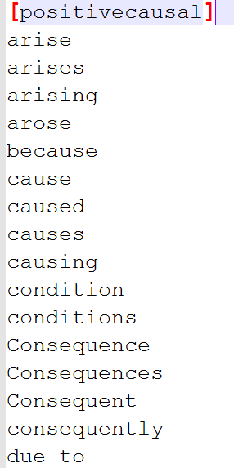
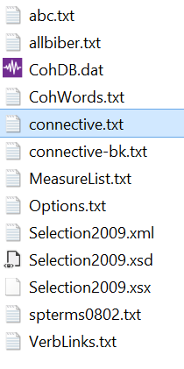
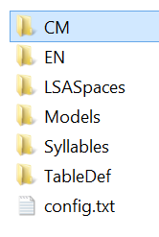

Slide 33
Connectives
Connect and relate sentences and paragraphs.
Assist in the logical flow of ideas as they signal the relationship between sentences and paragraphs.
Signal order, relationship and movement.
Now this is the next tale, and it tells how the Camel got his big hump. In the beginning of years, when the world was so new and all, and the Animals were just beginning to work for Man, there was a Camel, and he lived in the middle of a Howling Desert…

Slide 34
Positive Causal
hence, a consequence of, all in all, for, …
Positive Intentional
so, by, in order, for, …
Positive Logical
actually, after all, all in all, also, anyway, …
Positive Temporal
after, earlier, before, …
Positive Additive
also, and, …

Slide 35
Negative Causal
unless, even though, though, nevertheless, …
Negative Logical
but, on the contrary, however, whereas, yet, …
Negative Temporal
until, until then, …
Negative Additive
anyhow, in contrast, or, rather, yet, …

Slide 36
Concepts:
Incidence scores versus Ratio scores
Incidence: number of classified units per 1000 words.
Ratio: one class of units divided by another class of units

Slide 37
Indices: Word Information(I)
84 WRDNOUN Noun incidence
85 WRDVERB Verb incidence
86 WRDADJ Adjective incidence
87 WRDADV Adverb incidence
Content Words

Slide 38
Indices: Word Information(II)
88 WRDPRO Pronoun incidence
89 WRDPRP1s First person singular pronoun incidence
90 WRDPRP1p First person plural pronoun incidence
91 WRDPRP2 Second person pronoun incidence
92 WRDPRP3s Third person singular pronoun incidence
93 WRDPRP3p Third person plural pronoun incidence
Pronouns

Slide 39
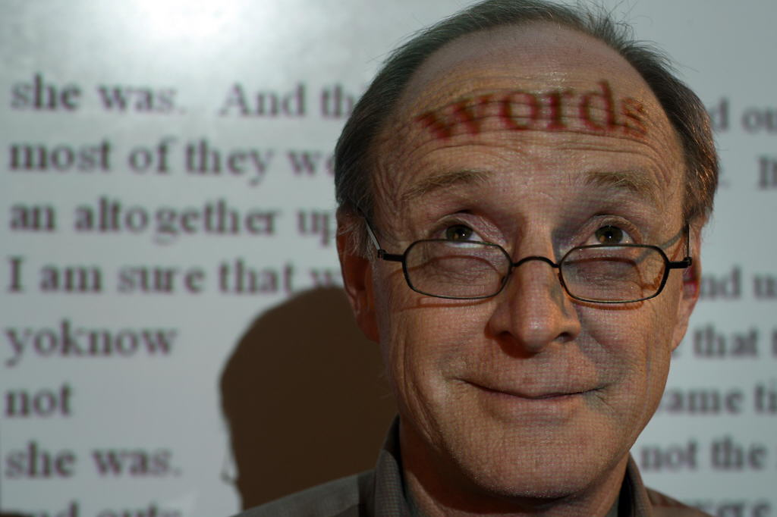
James W. Pennebaker
Texas

Slide 40
Indices: Word Information(III)
94 WRDFRQc CELEX word frequency for content words
95 WRDFRQa CELEX Log frequency for all words
96 WRDFRQmc CELEX Log minimum frequency for content words
Word Frequency

Slide 41
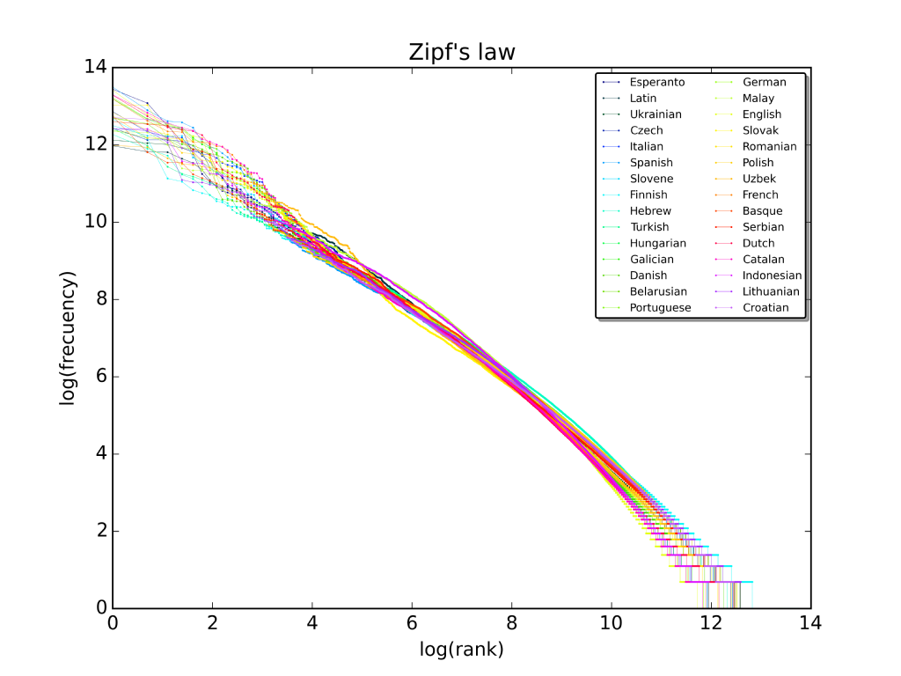
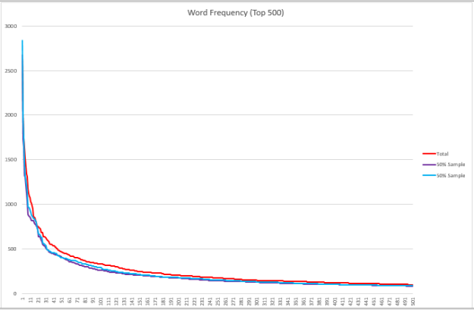
Notes:
A plot of the rank versus frequency for the first 10 million words in 30 Wikipedias (dumps from October 2015) in a log-log scale.

Slide 42
Indices: Word Information(IV)
97 WRDAOAc Age of acquisition
98 WRDFAMc Familiarity
99 WRDCNCc Concreteness
100 WRDIMGc Imagability
101 WRDMEAc Meaningfulness
Human rated – MRC DB

Slide 43
Indices: Word Information(IV)
WordNet freatures
102 WRDPOLc Polysemy for content words
103 WRDHYPn Hypernymy for nouns
104 WRDHYPv Hypernymy for verbs
105 WRDHYPnv Hypernymy for nouns and verbs
Polysemy：number of senses of a word.
Hypernymy: average number of hypernymy levels to the root of a word.

Slide 44
Indices: Word Information(IV)
WordNet freatures
Abstract
Concrete

Slide 45
Indices: Lexical Diversity
48 LDTTRc Lexical diversity, type-token ratio, content word lemmas
49 LDTTRa Lexical diversity, type-token ratio, all words
50 LDMTLDa Lexical diversity, MTLD, all words
51 LDVOCDa Lexical diversity, VOCD, all words

Slide 46
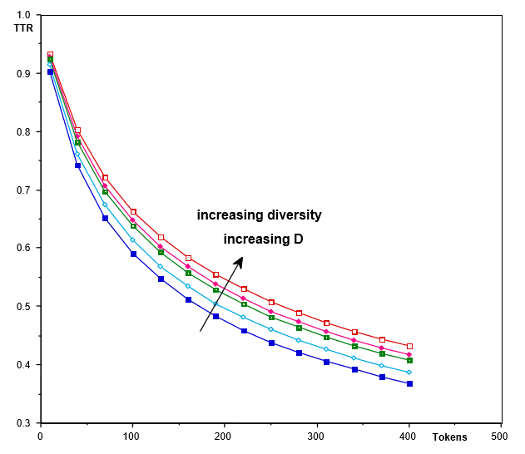
VOCD: Vocabulary Diversity(1)
Sichel’s (1986) type-token characteristic curve, where N is the number of tokens and D a parameter.
Malvern, D.D. Richards, B.J., Chipere, N. and Durán, P. 2004: Lexical diversity and language development: Quantification and assessment. Houndmills, Hampshire: Palgrave Macmillan.

Slide 47
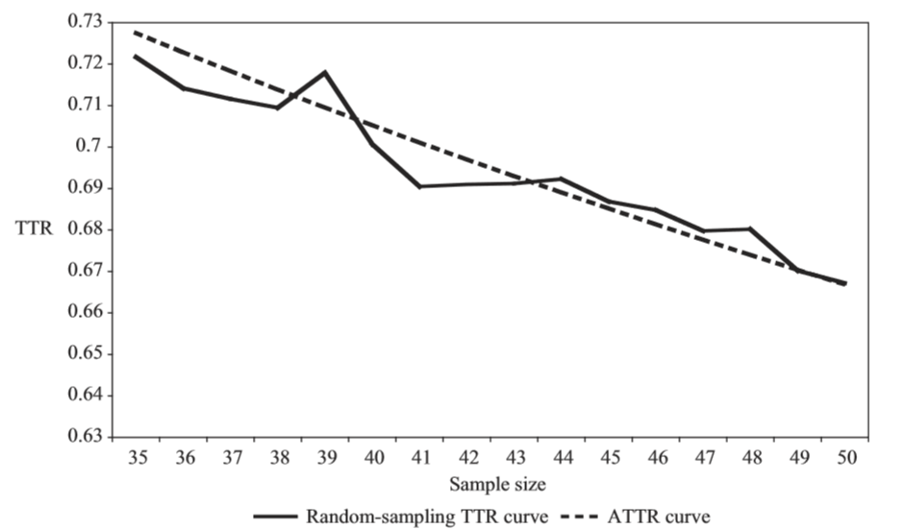
VOCD: Vocabulary Diversity (II)
vocd: A theoretical and empirical evaluation
Philip M. McCarthy, Scott Jarvis, First Published October 1, 2007 Research Article
https://doi.org/10.1177/0265532207080767

Slide 48
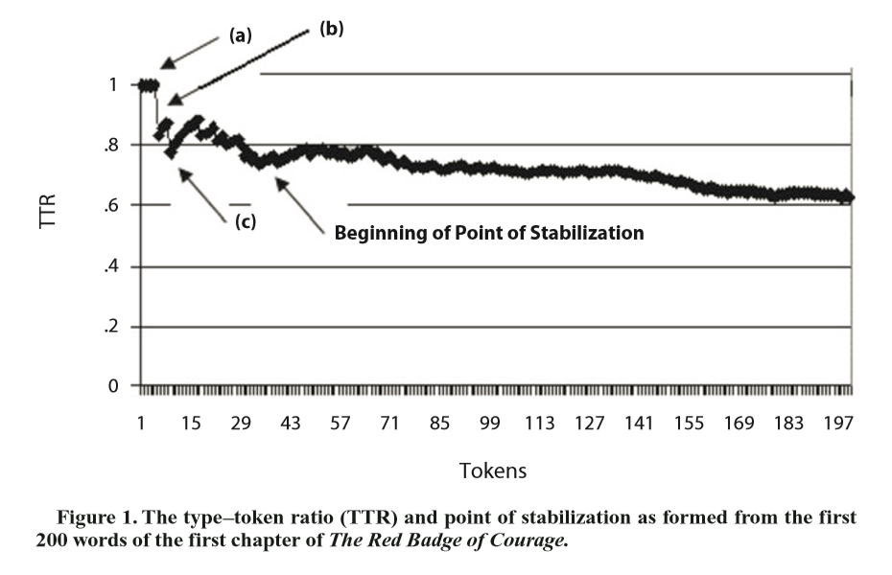
MTLD: Mesure of Textural Lexical Diversity
McCarthy, P. M. & Jarvis, S. (2010). MTLD, vocd-D, and HD-D: A validation study of sophisticated approaches to lexical diversity assessment. Behavior Research Methods, 42, 381-392.

Slide 49
Indices: Syntactic Pattern Density
(incidence)
76 DRNP Noun phrase density
77 DRVP Verb phrase density
78 DRAP Adverbial phrase density
79 DRPP Preposition phrase density
80 DRPVAL Agentless passive voice density
81 DRNEG Negation density
82 DRGERUND Gerund density
83 DRINF Infinitive density

Slide 50
Indices: Syntactic Complexity(I)
69 SYNLE Left embeddedness, words before main verb
70 SYNNP Number of modifiers per noun phrase
SYNNP=4/2
SYNLE=3

Slide 51
Indices: Syntactic Complexity(II)
e.g.
took
vb
take
71 SYNMEDpos Minimal Edit Distance, part of speech
72 SYNMEDwrd Minimal Edit Distance, all words
73 SYNMEDlem Minimal Edit Distance, lemmas
Vladimir Levenshtein 1965
The minimum number of point mutations required to change s1 into s2, where a point mutation is one of:
1. change a letter,
2. insert a letter, or
3. delete a letter
Example: kitten => sitting
sitten（k→s） change
sittin（e→i） change
sitting（→g） insert
N=3, Yes.
MED=3? Minimum?
Note: In Coh-Metrix, the operations are applied to words, not letters.

Slide 52
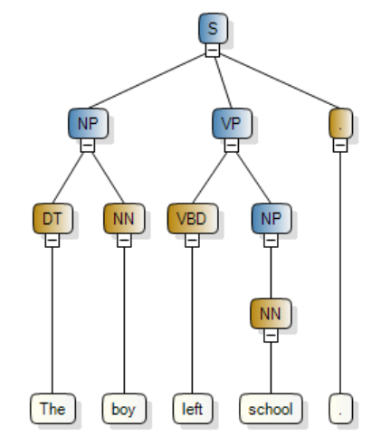
Indices: Syntactic Complexity(II)
74 SYNSTRUTa Sentence syntax similarity, adjacent sentences
75 SYNSTRUTt Sentence syntax similarity, all combinations, across paragraphs

Slide 53
Indices: Referential Cohesion(I)
28 CRFNO1 Noun overlap, adjacent sentences
29 CRFAO1 Argument overlap, adjacent sentences
30 CRFSO1 Stem overlap, adjacent sentences
31 CRFNOa Noun overlap, all sentences
32 CRFAOa Argument overlap, all sentences
33 CRFSOa Stem overlap, all sentences
Note: Overlap for each pair of sentences is a binary value.

Slide 54
Concepts:
Adjacent versus All sentences
Adjacent sentences: successive sentences in a span of text.
Example:
If a span of text has 4 sentences, then the adjacent sentences would be sentences 1-2, 2-3, and 3-4.
All sentences: all possible pairs of sentences
Example:
1-2, 2-3, 3-4, 1-3, 1-4, and 2-4.

Slide 55
Indices: Referential Cohesion(II)
34(35) CRFCWO1(d) Content word overlap, adjacent sentences (std)
36(37) CRFCWOa Content word overlap, all sentences (std)
38(39) CRFANP1 CREFP1u Anaphor overlap, adjacent sentences (std)

Slide 56
Indices: Situation Model
61 SMCAUSv Causal verb incidence
62 SMCAUSvp Causal verbs and causal particles incidence
63 SMINTEp Intentional verbs incidence
64 SMCAUSr Ratio of casual particles to causal verbs
65 SMINTEr Ratio of intentional particles to intentional verbs
66 SMCAUSlsa LSA verb overlap
67 SMCAUSwn WordNet verb overlap
68 SMTEMP Temporal cohesion, tense and aspect repetition

Slide 57
Indices: LSA
40 LSASS1(d) LSA overlap, adjacent sentences(std)
42 LSASSp(d) LSA overlap, all sentences in paragraph(std)
44 LSAPP1(d) LSA overlap, adjacent paragraphs (std)
46 LSAGN LSA given/new, sentences (std)

Slide 58
LSA:
Latent Semantic Analysis
Meaning Representation
潜在语义分析

Slide 59
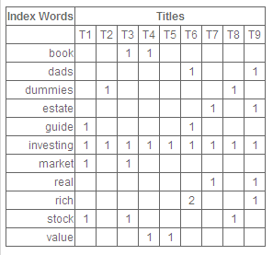
Term-Document Frequencies

Slide 60
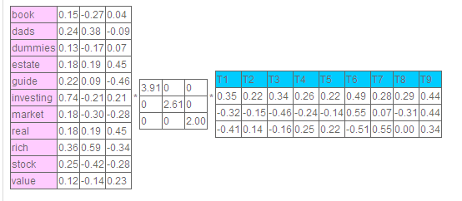
SVD and Low Rank Approximation
Rank-3 approximation

Slide 61
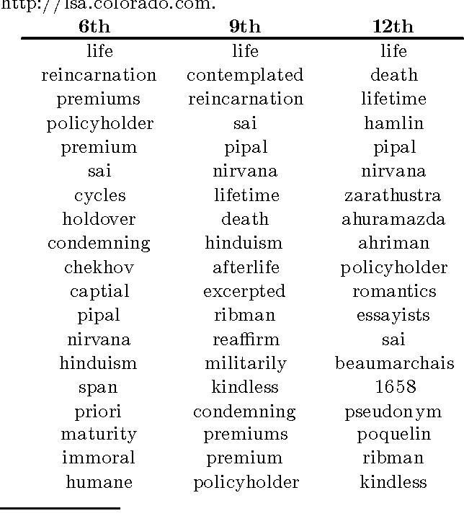
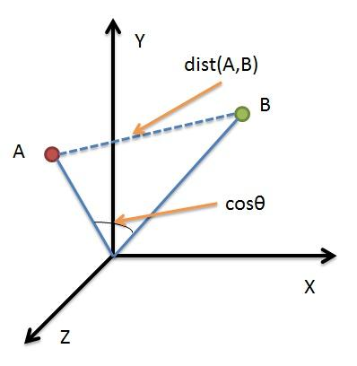
Cosine and Nearest Neighbors

Slide 62
LSA Example Applications
TOEFL Test
LSA score: 64.4% correct.
Student average: 64.5% correct.
Essay Grading
Two ETS reader: R=0.77
LSA and reader 1: R=0.68
LSA and reader 2: R=0.77
AutoTutor Answer Evaluation
Human judgment: R=0.70
LSA + RegEx: R=0.67

Slide 63
Meanings are Different in Different Spaces
Corpus | Docs | Dim | Nearest Neighbors
Physics | 4000 | 17 | exert, act, pull, experience, push
Random | 4000 | 17 | belligerent, offensive, gun, command, patrol
TASA | 37651 | 300 | unbalanced, exert, centripetal, turntable, Newton
Nearest neighbors of “force” in different spaces

Slide 64
Research Questions
What is a good domain corpus?
How large is enough?

Slide 65
Research Question
max | 0.005 | -0.003 | -0.002 | -0.007 | 0.000
rockets | 0.009 | -0.005 | 0.038 | -0.014 | 0.014
heaviside | 0.001 | 0.000 | -0.001 | -0.001 | 0.000
smith | 0.002 | 0.002 | -0.003 | -0.002 | -0.002
dharma | 0.000 | 0.000 | -0.001 | 0.000 | 0.000
man | 0.003 | -0.001 | 0.004 | -0.004 | 0.001
attempting | 0.003 | -0.003 | 0.002 | 0.002 | 0.004
torsion | 0.006 | -0.008 | -0.004 | 0.009 | 0.008
impactor | 0.002 | -0.003 | 0.004 | 0.000 | 0.001
law | 0.056 | 0.001 | -0.083 | 0.028 | 0.022
probability | 0.002 | -0.001 | -0.001 | -0.006 | 0.000
explaining | 0.002 | -0.001 | -0.003 | 0.000 | 0.000
How many dimensions are enough?
?
max | 0.005 | -0.003 | -0.002 | -0.007 | 0.000 | 0.009 | -0.006 | -0.006 | 0.003 | 0.008 | 0.000 | 0.016
rockets | 0.009 | -0.005 | 0.038 | -0.014 | 0.014 | 0.028 | -0.018 | 0.029 | 0.007 | 0.030 | 0.010 | -0.016
heaviside | 0.001 | 0.000 | -0.001 | -0.001 | 0.000 | 0.005 | -0.001 | -0.004 | -0.002 | -0.001 | 0.001 | 0.007
smith | 0.002 | 0.002 | -0.003 | -0.002 | -0.002 | 0.006 | -0.002 | -0.007 | -0.004 | 0.010 | -0.001 | 0.002
dharma | 0.000 | 0.000 | -0.001 | 0.000 | 0.000 | 0.000 | 0.000 | 0.000 | 0.000 | 0.000 | 0.000 | 0.000
man | 0.003 | -0.001 | 0.004 | -0.004 | 0.001 | -0.004 | -0.005 | 0.002 | -0.004 | -0.005 | 0.002 | 0.014
attempting | 0.003 | -0.003 | 0.002 | 0.002 | 0.004 | 0.006 | -0.001 | 0.000 | 0.003 | -0.001 | 0.004 | 0.001
torsion | 0.006 | -0.008 | -0.004 | 0.009 | 0.008 | -0.019 | -0.021 | -0.024 | -0.008 | 0.017 | -0.021 | 0.036
impactor | 0.002 | -0.003 | 0.004 | 0.000 | 0.001 | 0.003 | 0.004 | -0.004 | 0.003 | -0.002 | 0.003 | 0.002
law | 0.056 | 0.001 | -0.083 | 0.028 | 0.022 | -0.063 | -0.028 | 0.003 | 0.009 | 0.084 | 0.022 | 0.030
probability | 0.002 | -0.001 | -0.001 | -0.006 | 0.000 | 0.001 | 0.003 | -0.008 | 0.002 | -0.001 | 0.002 | 0.001
explaining | 0.002 | -0.001 | -0.003 | 0.000 | 0.000 | 0.001 | -0.002 | -0.002 | -0.001 | 0.003 | 0.003 | 0.003

Slide 66
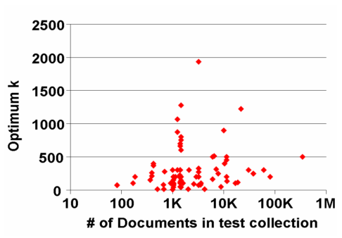
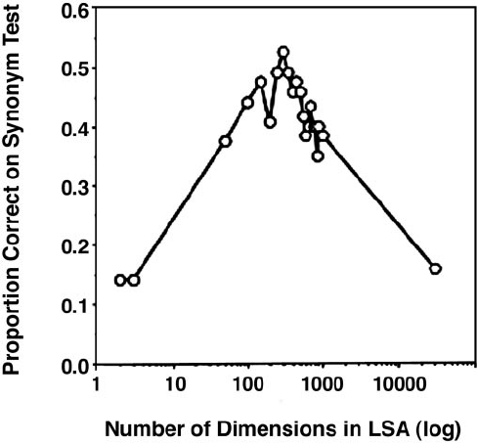
Corpus Size and Optimal Dimensions
Landauer, Laham, & Derr, 2004
Bradford, 2008
Kontostathis, 2007

Slide 67
From Documents to Vector Space
LSA (LSI)
pLSA
LDA
Word2Vec
……
max | 0.005 | -0.003 | -0.002 | -0.007 | 0.000
rockets | 0.009 | -0.005 | 0.038 | -0.014 | 0.014
heaviside | 0.001 | 0.000 | -0.001 | -0.001 | 0.000
smith | 0.002 | 0.002 | -0.003 | -0.002 | -0.002
dharma | 0.000 | 0.000 | -0.001 | 0.000 | 0.000
man | 0.003 | -0.001 | 0.004 | -0.004 | 0.001
attempting | 0.003 | -0.003 | 0.002 | 0.002 | 0.004
torsion | 0.006 | -0.008 | -0.004 | 0.009 | 0.008
impactor | 0.002 | -0.003 | 0.004 | 0.000 | 0.001
law | 0.056 | 0.001 | -0.083 | 0.028 | 0.022
probability | 0.002 | -0.001 | -0.001 | -0.006 | 0.000
explaining | 0.002 | -0.001 | -0.003 | 0.000 | 0.000

Slide 68
Indices: Readability
106 RDFRE Flesch Reading Ease
107 RDFKGL Flesch-Kincaid Grade Level
108 RDL2 Coh-Metrix L2 Readability
206.835 – (1.015 x ASL) – (84.6 x ASW) ASL = Average Sentence Length ASW = Average number of syllables per word Range: 0 to 100. 90.0 ~ 100.0: easily understandable by an average 5th grader. 60.0 ~ 70.0: easily understood by 8th and 9th graders. 0.0 and 30.0: understood by college graduates.

Slide 69
Indices: PCA Scors
12(13) PCNARz(p) Narrativity
14(15) PCSYNz(p) Syntactic simplicity
16(17) PCCNCz(p) Word concreteness
18(19) PCREFz(p) Referential cohesion
20(21) PCDCz(p) Deep cohesion
22(23) PCVERBz(p) Verb cohesion
24(25) PCCONNz(p) Connectivity
26(27) PCTEMPz(p) Temporality
z: z- score
p: percentile

Slide 70
Measure of Academic Language: Formality
Graesser, McNamara, Cai, Conley, Li, & Pennebaker, 2014;
Li, Cai, & Graesser, 2013;
Coh-Metrix formality
Formality = (deep cohesion + referential cohesion
− narrativity − word concreteness
− syntactic simplicity)/5
Informal Formal
-1
0
1
Formality of science reading for 6th~8th graders
Notes:
Academic language of CER was measured by Coh-Metrix formality. Specifically, formality increases with more abstract words, syntactic complexity, high cohesion, and more informational text.
Our previous studies showed that formality of science reading for middle school students was slightly below 0.
Numbers higher than 0 represent more formal discourse. Numbers below 0 represent more informal discourse.
This implies that if student formality in writing reaches 0, their use of academic language is equivalent to the academic language used in their informational reading materials.

Slide 71
END

