Slide 1
Learning Intervention with Implicit Feedback —Empower MOOCs with AI
Jie Tang
Tsinghua University

Slide 2
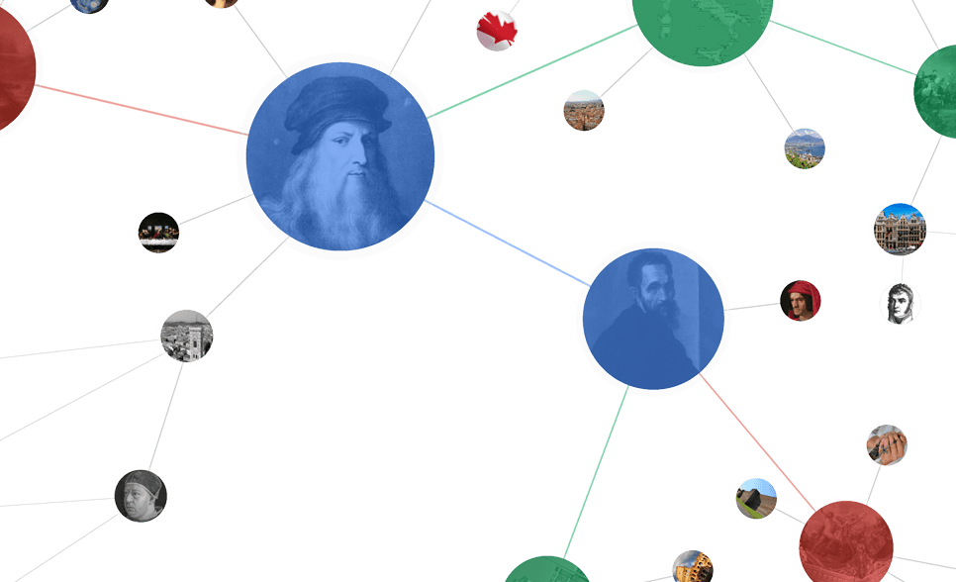
Big Data in MOOC
149 partners
2400+ courses
33,000,000 users
1,000+ courses
10,000,000 users
Chinese EDU association
110 partners
1,800 courses
14,000,000 users
10+ MicroMaster
host >1,000 courses
millions of users
~10 partners
40+ courses
1.6 million users
“nanodegree”
……
Notes:
In October 2014 edX announced Professional Education courses,^{[28]} and in March 2015 it partnered with Microsoft.
In April 2015, edX partnered with Arizona State University to launch the Global Freshman Academy.^{[30]}
大学mooc—高教
Mooc研究院

Slide 3
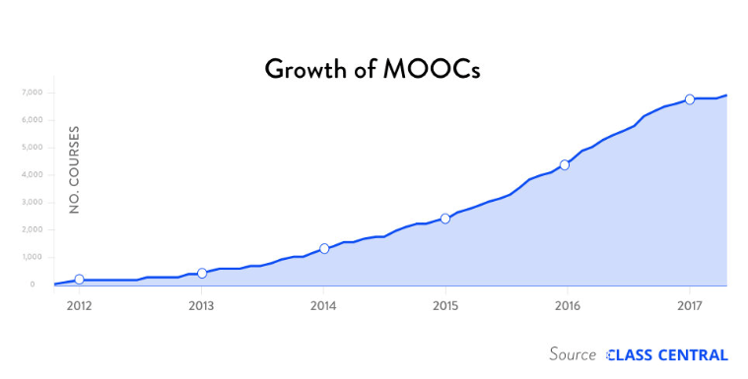

Slide 5
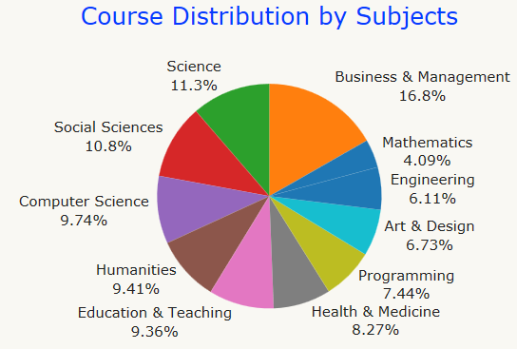

Slide 6
Coursera

Slide 8
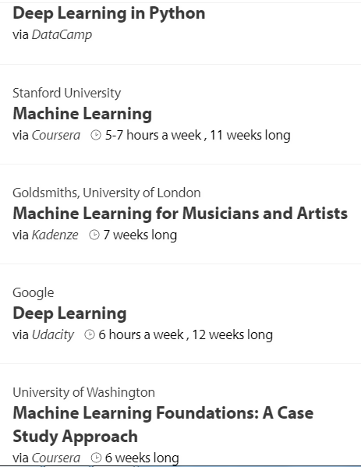
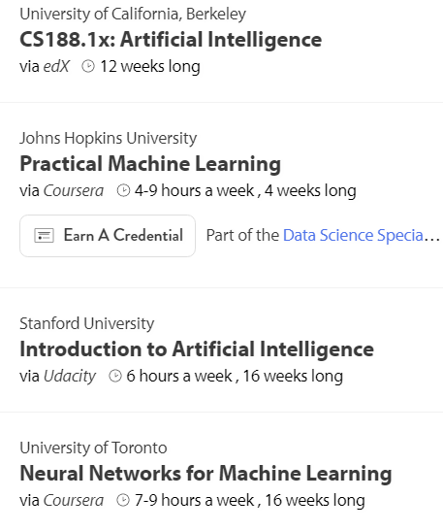

Slide 9
XuetangX
Launched in 2013

Slide 10
Some exciting data…
Every day, there are 10,000+ new students
An MOOC course can reach 100,000+ students
>35% of the XuetangX users are using mobile
traditional->flipped classroom->online degree
Notes:
—XuetangX help leverage the spare time (e.g. on train, bus, etc.)
Traditional class: students listen to the lecture and the homework is assigned to demonstrate understanding
Flipped class: students watched video before coming to class and finish “homework” at the class time

Slide 11
2018: Advertisement
This year is the 5th anniversary of XuetangX
We will have a ceremony tomorrow!

Slide 12
However…
certificate rate < 3%
The highest certificate rate is 14.95%
The lowest is only 0.84%
Can AI help MOOC and how?

Slide 13
MOOC user = Student?
How to learn more effectively and more efficiently?
?
Who is who? background, where from?
Why MOOC? motivation? degree?
What is personalization? preference?

Slide 14
MOOC course = University course?
How to discover the prerequisite relations between concepts and generate the concept graph automatically?
artificial intelligence
data mining
machine learning
data clustering
association rule
Thousands of Courses
Probability Distribution
Hidden Markov Model
Maximum Likelihood
How to leverage the external knowledge?
Notes:
curriculum

Slide 15
However to improve the engagement?
?
artificial intelligence
data mining
machine learning
data clustering
association rule
User
Knowledge

Slide 16
XiaoMU (小木)

Slide 17
What is XiaoMU? Another Watson?

Slide 18
What is XiaoMU(“小木”)
Not a Chatbot
“Good morning”, “did you have the breakfast?”—NO
Not a teacher/TA
“Can you explain the equation for me?” —NO
Instead,“小木” is more like a learning peer
Tell you some basic knowledge in her mind
Tell you what the other users are thinking/learning
Try to understand your intention
Teach “小木” what you know

Slide 19
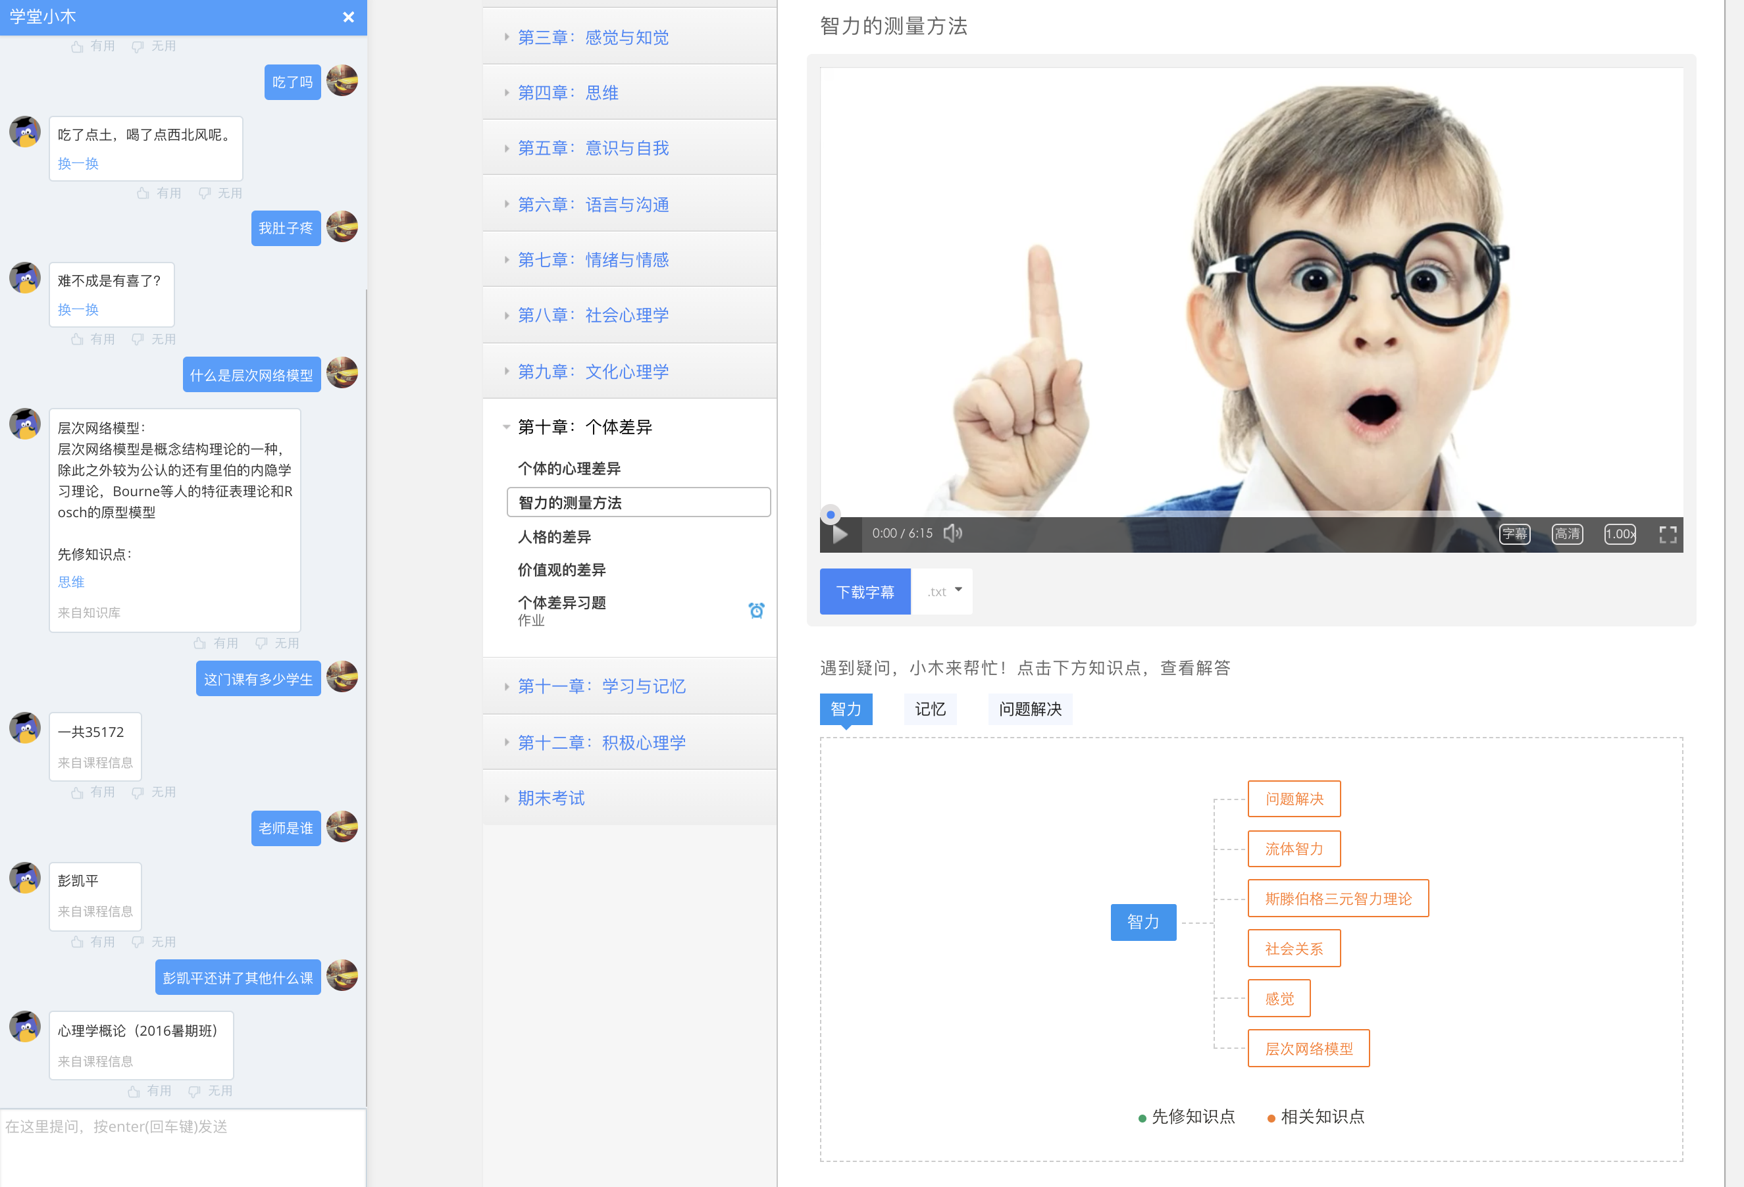
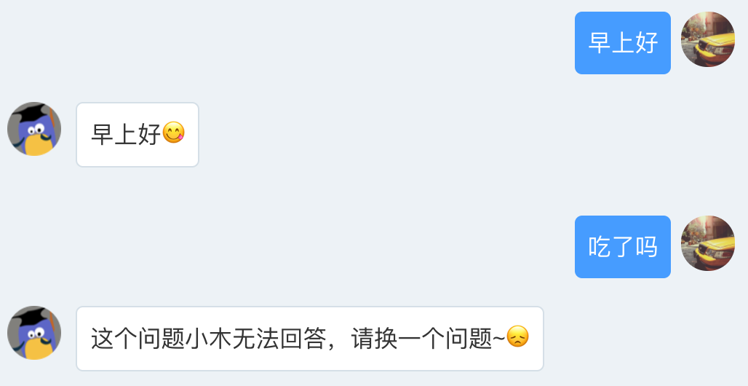
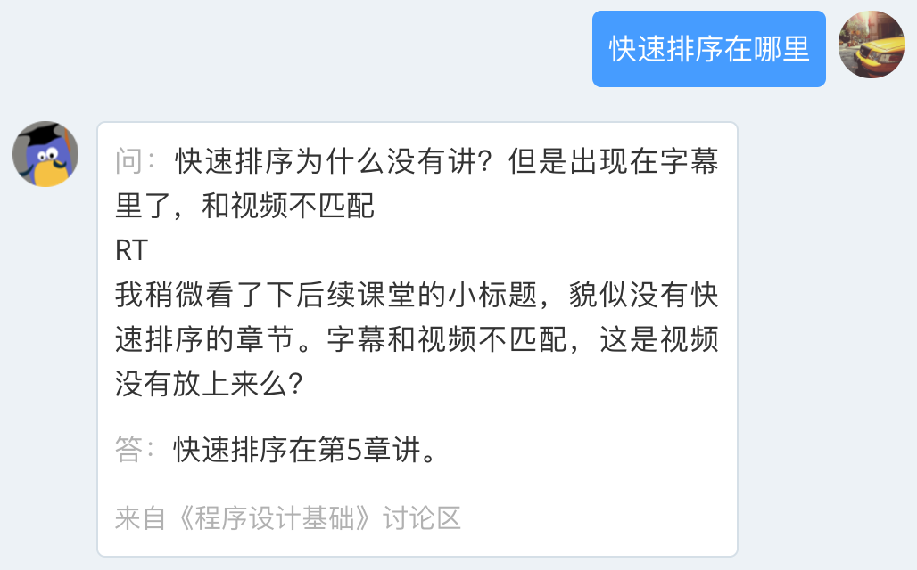
What is XiaoMU(“小木”)
Knowledge Graph

Slide 20
XiaoMU: Smart Jump
Jump-back
Navigation
Distribution
0.07
0.35
0.11
0.26
Personalized Suggestion
Let’s begin with …
First, we introduce …
The example is that …
Next … capital assets … investment property …

Slide 21
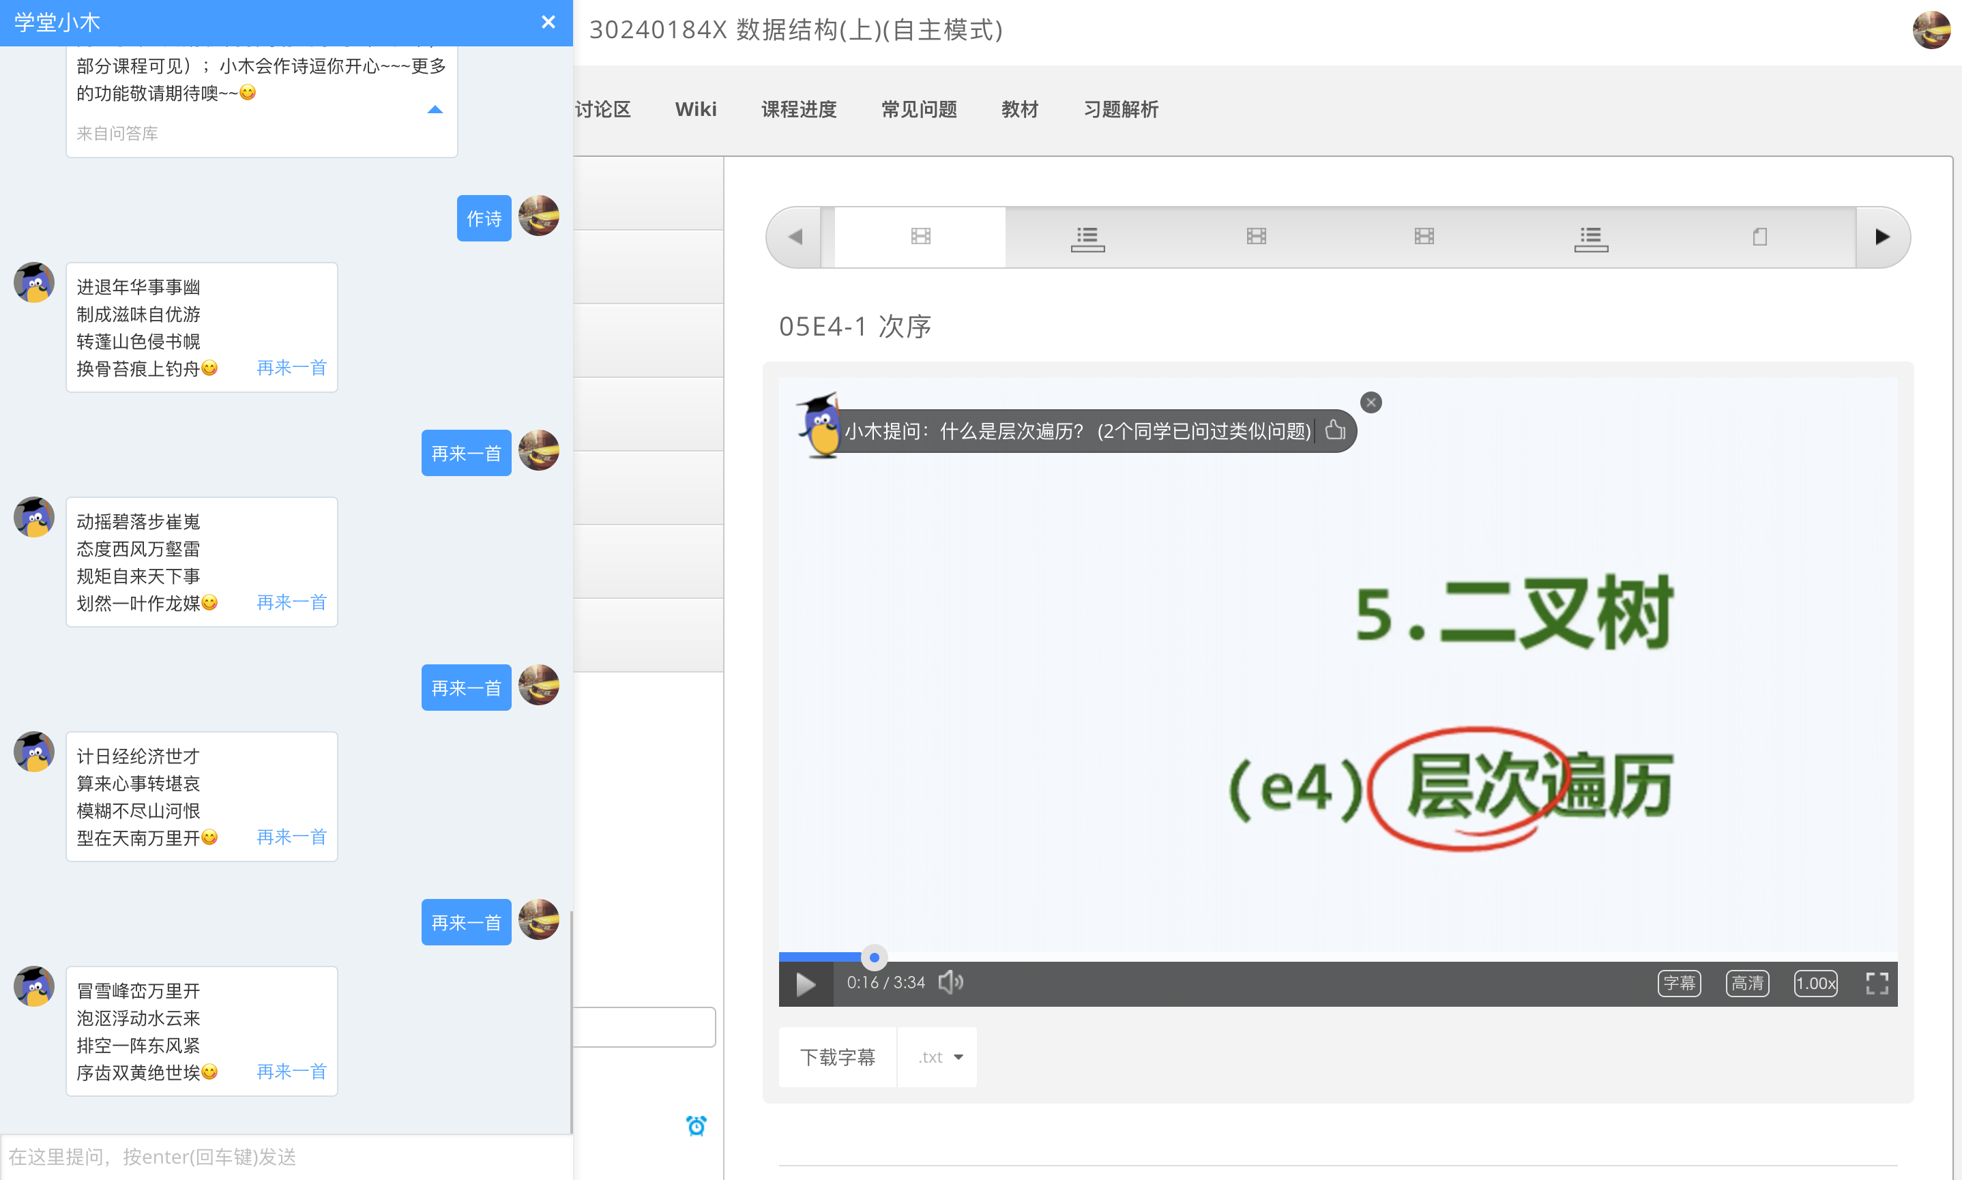
Acrostic Poem: 小木作诗—by 九歌

Slide 22
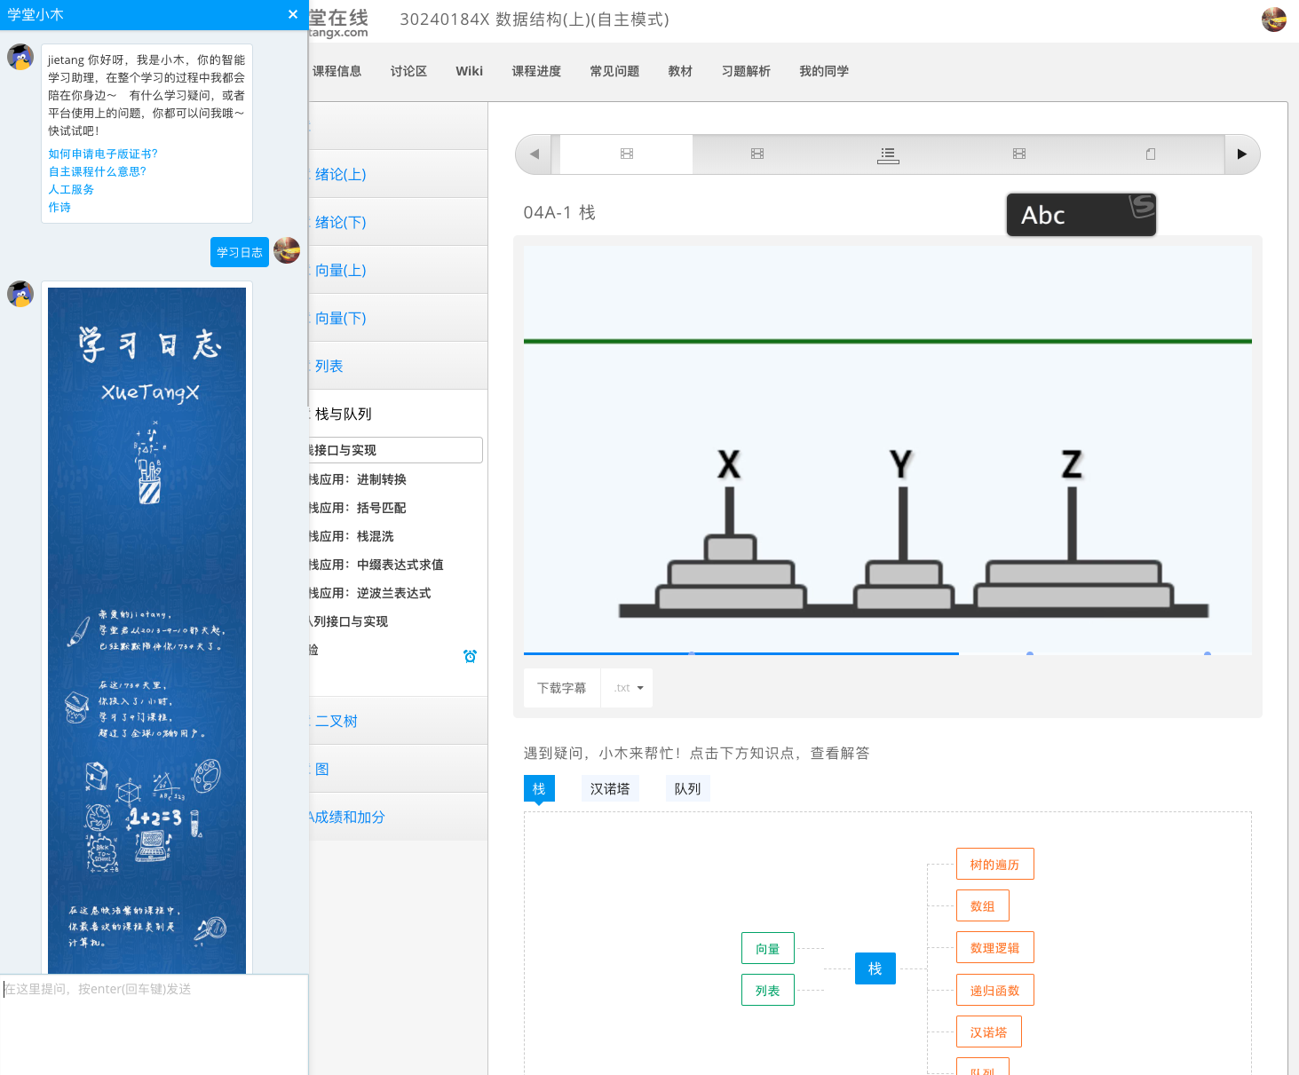
XiaoMU: Learning Diary

Slide 23
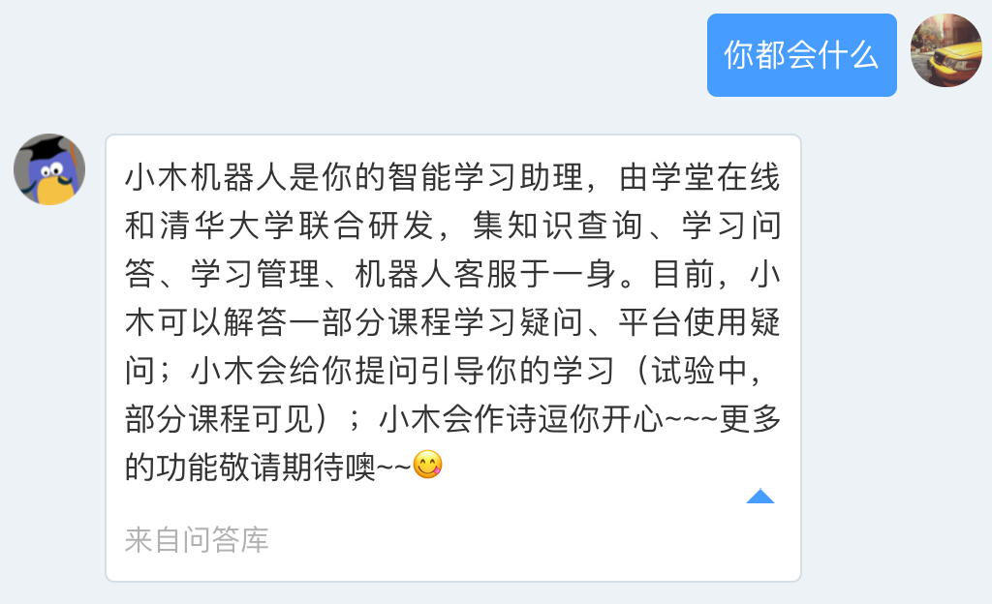
What is XiaoMU (“小木”)

Slide 24
XiaoMU (小木)
But most existing systems focus on passively interactions…
User Modeling
Intervention
Content Analysis

Slide 25
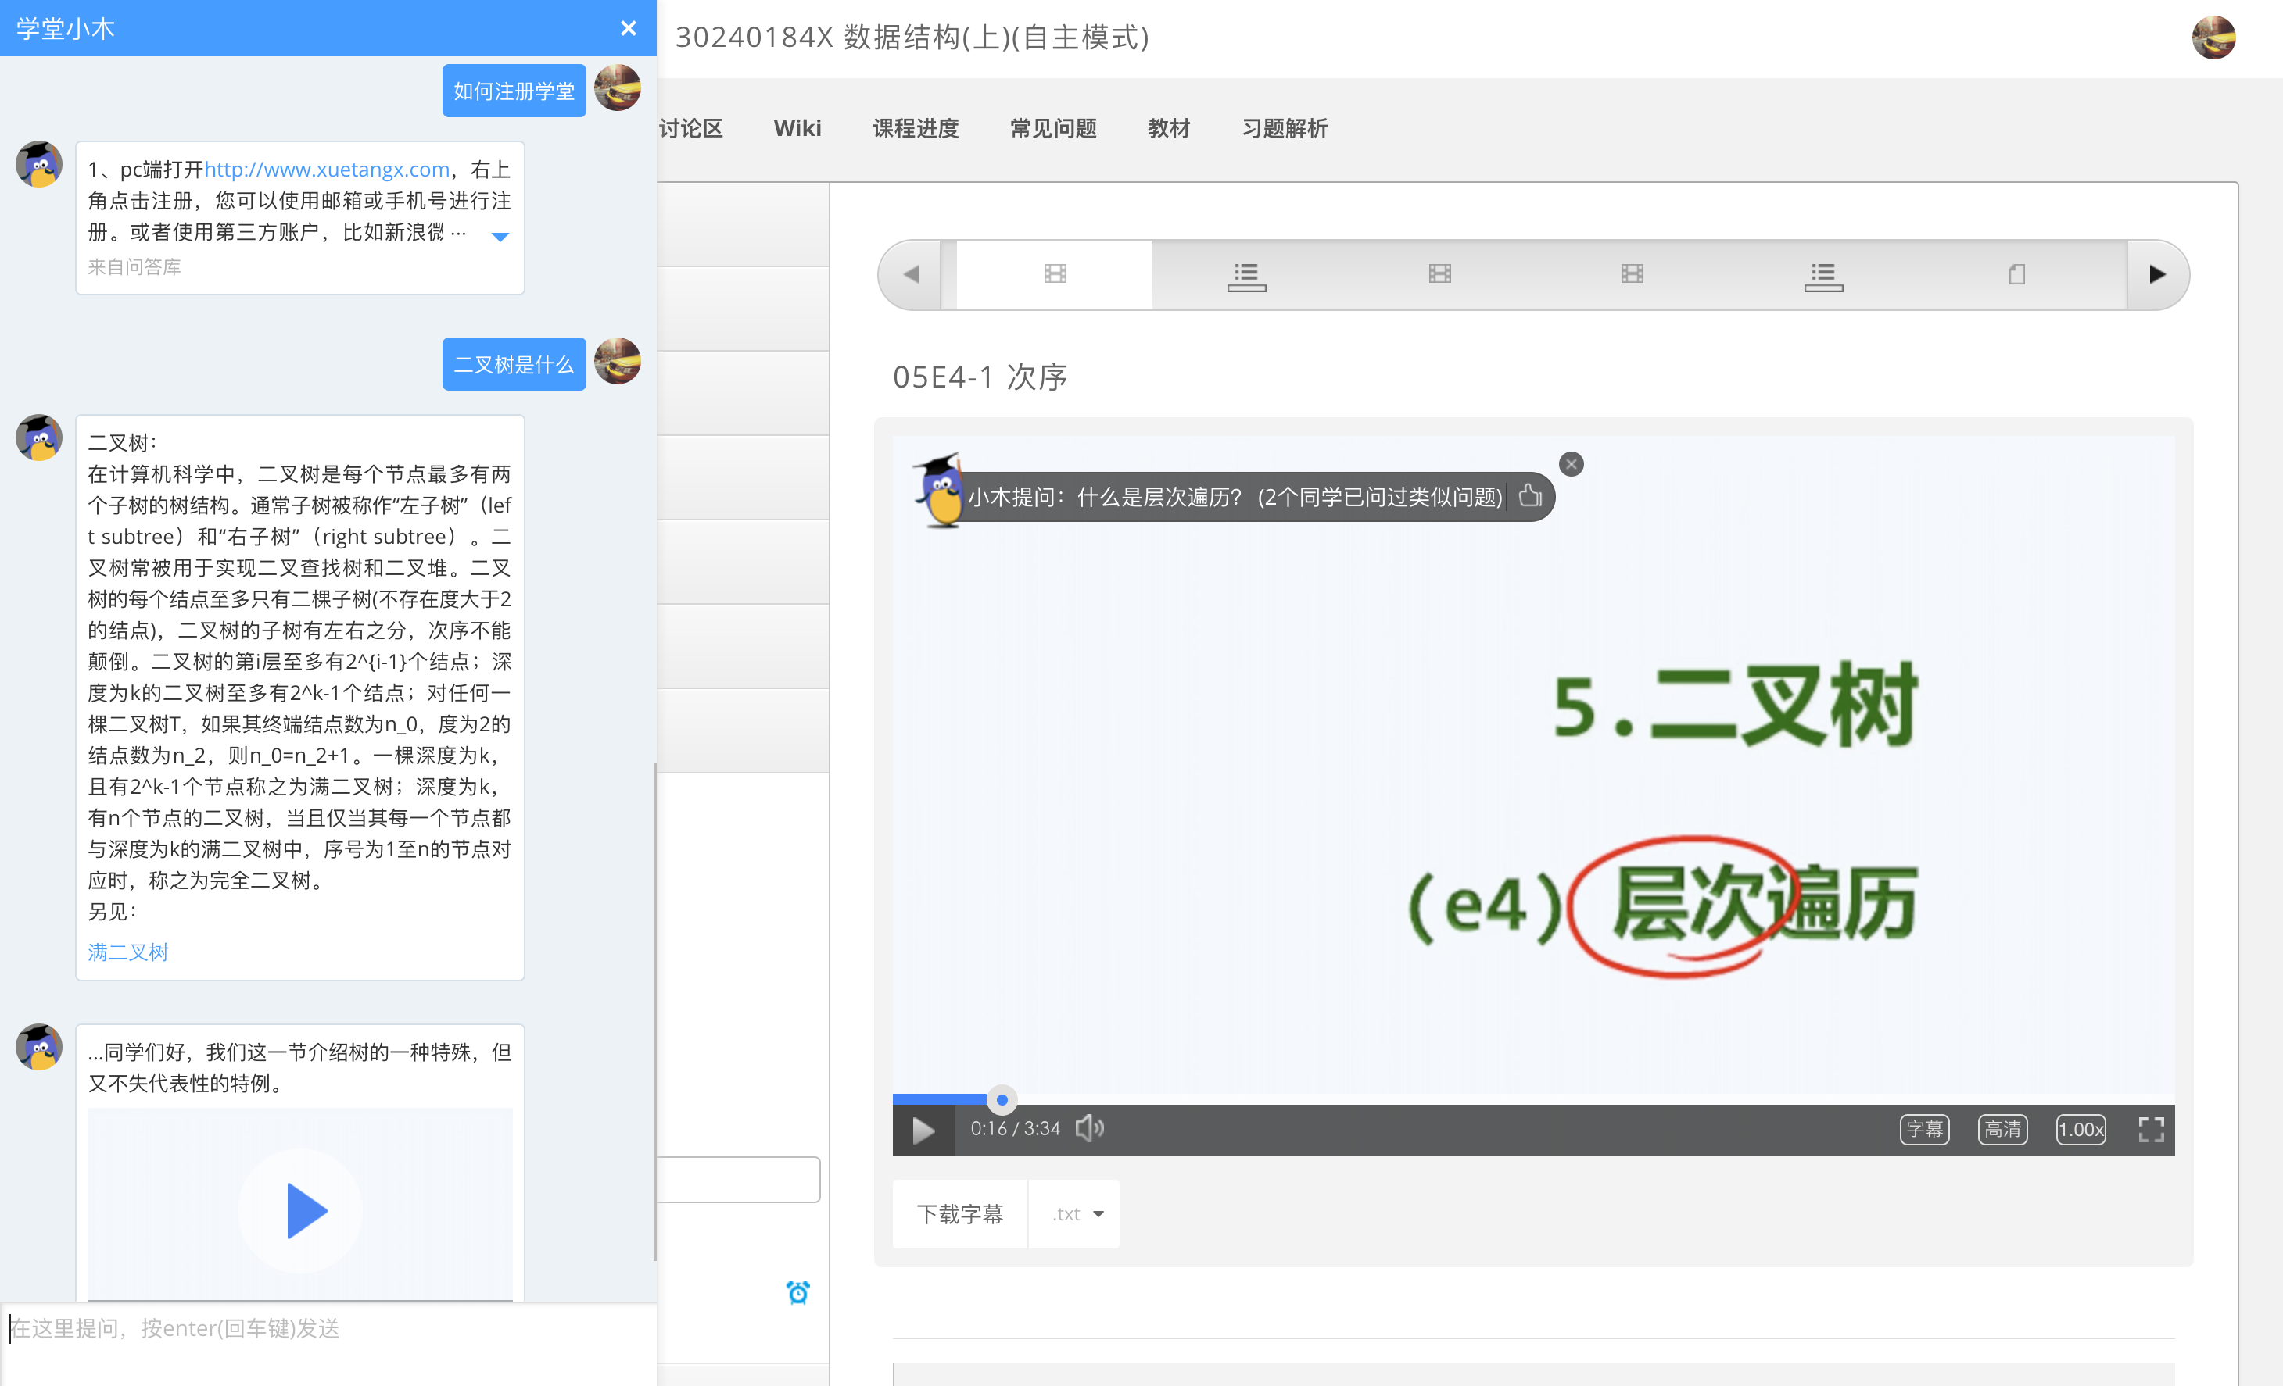
XiaoMU (小木)

Slide 26
XiaoMU would like to ask you

Slide 27
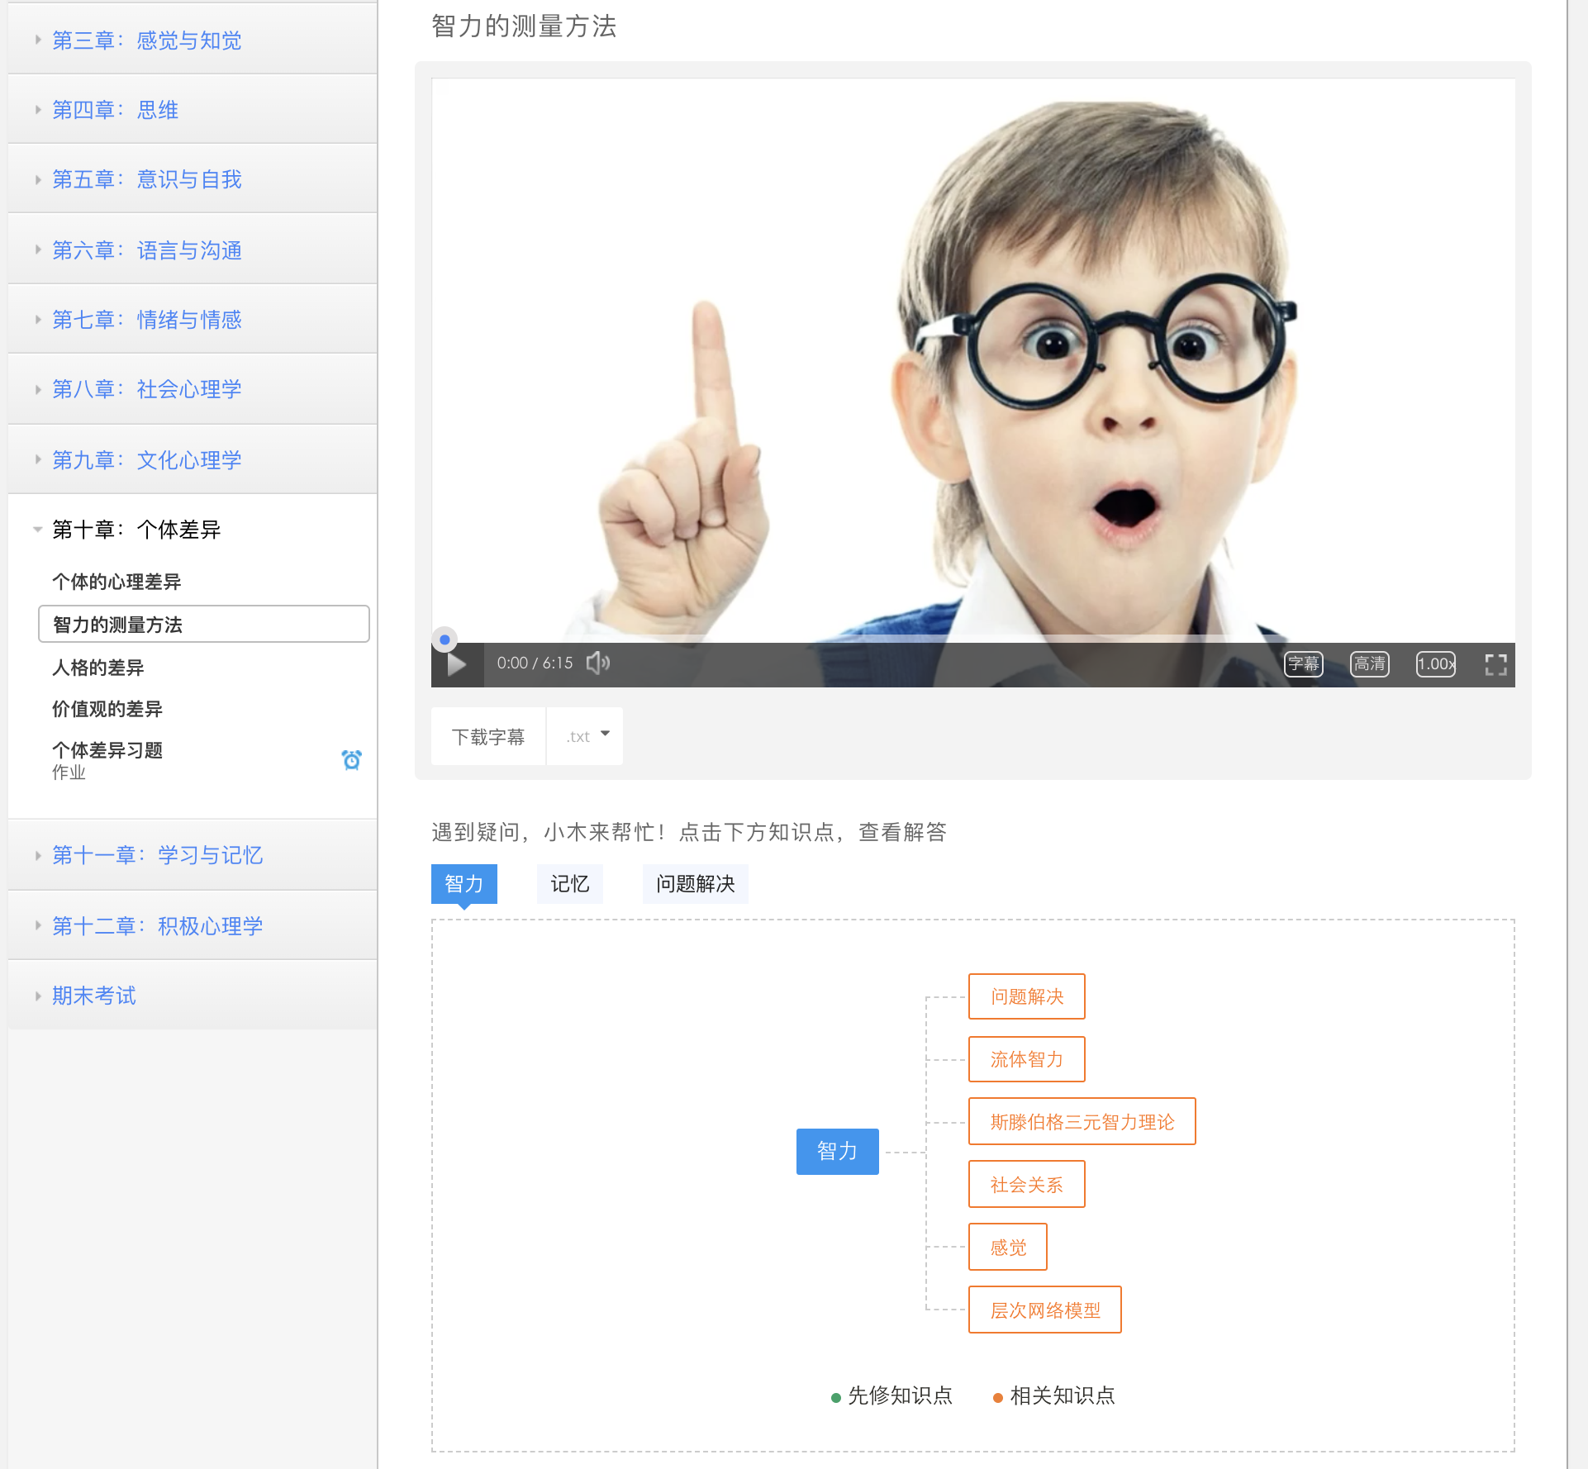
XiaoMU: Knowledge Graph
Knowledge Graph

Slide 28
One example of intervention: active question
Question: What are the shortcomings of Raven Progressive Test? (3 users thumbs up)
Fundamental Challenges (3W):
When
to Whom
ask What (question)

Slide 29
Preliminary study—first version
Question: What are the shortcomings of Raven Progressive Test?

Slide 30
Active Question by Bot
are those interventions really useful?
not enough…
On |  | Off
137 |  | 129

Slide 31
Preliminary study—second version
Question: What are the shortcomings of Raven Progressive Test? (3 users thumbs up)

Slide 32
Active Question
Positive Direct Feedback:
Time | Classified Type | Feedback ratio(at least once) | Thumb_up Ratio
0914 -- 0917 | On/Off | 12.4%(17/134) | 31.2%(10/32)
0923 -- 0930 | Social Pressure/None | 17.5%(151/864) | 47.1%(113/240)
Each question lasts for 10 seconds;
Displaying questions are selected manually to ensure strong connection with the on-going content;

Slide 33
Active Question
Longer Video Watching Time in total:
Class | Median Watch Time (second) | Average Watch Time (second) | User Count
On | 1329.5 | 3497.4 | 137
Off | 1864.0 | 2946.3 | 129
(t-test, p=0.303)

Slide 34
Now let us back to the technical part
Question: What are the shortcomings of Raven Progressive Test? (3 users thumbs up)
Fundamental Challenges (3W):
When
to Whom
ask What (question)

Slide 35
Bandit Learning with Implicit Feedback
[1] Yi Qi, Qingyun Wu, Hongning Wang, Jie Tang, and Maosong Sun. Bandit Learning with Implicit Feedback. NIPS'18.

Slide 36
Bandit (Online) Learning
An online learning framework: contextual bandit
Click/Buy etc. as reward, features of content/user/etc. as context.
Adaptively and sequentially learning
Successfully deployed for recommender system and ad displaying.
The problem is about the definition of rewards
Is non-click indicates negative impression?
Examination hypothesis:
Click occurs if and only if examination happens
Implication: no-click DOES NOT necessarily mean negative feedback

Slide 37
Model
Classical bandit model with linear reward:
Reward is 1 if clicked, 0 if non-clicked.
Inevitably linear regret.
Our model: E-C bandit (Examination-click bandit)
Thus:
The common goal: regret minimization

Slide 38
Model
E-C bandit
A generative model of click, explicitly incorporating examination;
Examination as a binary variable, is by nature NOT observable, thus a latent variable;
The essential problem
Is it possible to learn E-C bandit under online learning’s paradigm?
Regret analysis affirms learnability to some extent.
How to learning E-C bandit on the fly?
Variational approximation together with Thompson sampling

Slide 39
Algorithm– Parameter Estimation
The Log-likelihood of one sample:
The variational lower bound:
Jensen’s inequality for log-sum;
2-degree polynomial lower bound of log-logistic function;
Thus, a lower bound in the form of 2-degree polynomial, which leads to an approximate Gaussian posterior when given a Gaussian prior and allows for O(1) update.

Slide 40
Algorithm – Decision Making
Thompson sampling:
Choose any arm by its probability of being the best among the candidate;
Easy to implement and well integrated with our estimation procedure (Recall we have approximate Gaussian posterior of the parameters).

Slide 41
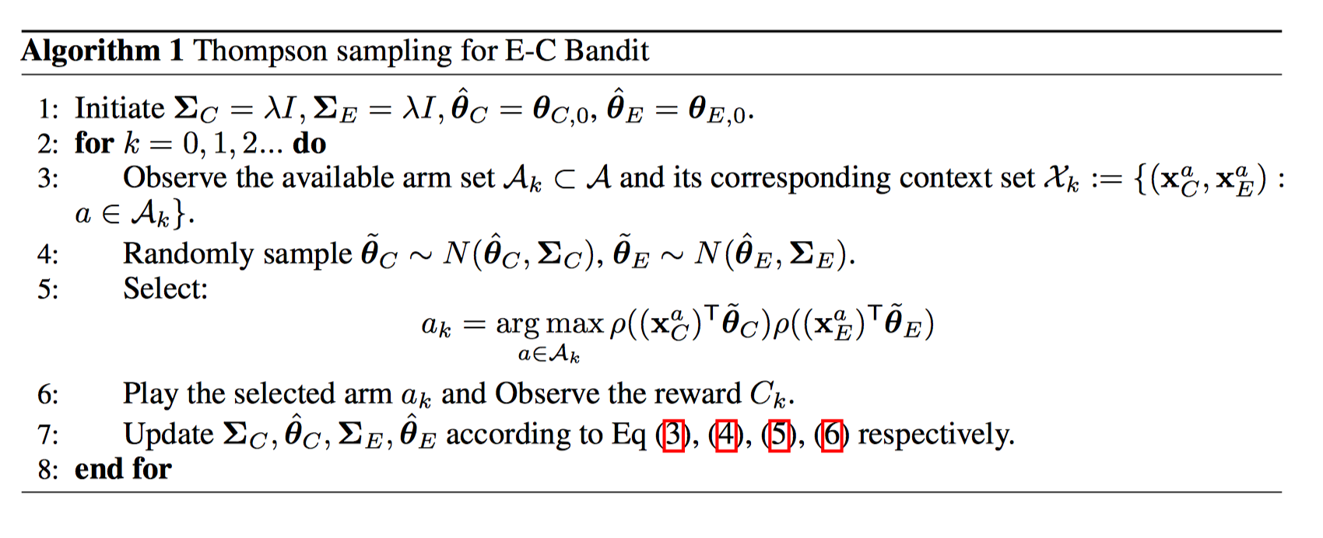
Algorithm

Slide 42
Regret Analysis
Sublinear regret is guaranteed if:
MLE estimate(i.e., log-loss estimate in our 0-1 reward case) is accurate;
Thompson sampling samples from the true posterior.
See detailed proof in the paper and appendix.
Proof’s framework is the same as Russo,2014. Key proposition: aggregated empirical discrepancy is bounded within a sub-linear increasing ellipse w.h.p.(Proposition 1 in the paper.)
By experiment we demonstrate the approximation is tight, and result improving.

Slide 43
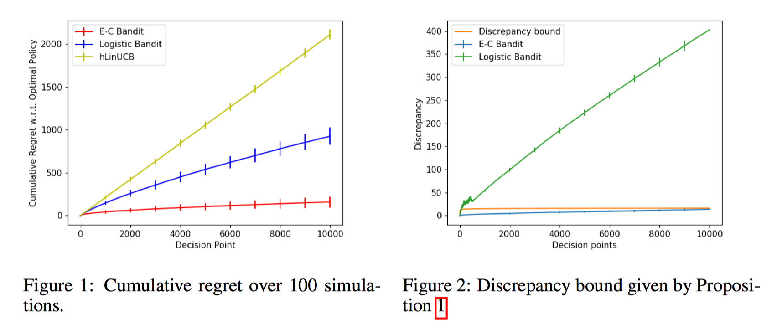
Evaluation - Simulation

Slide 44
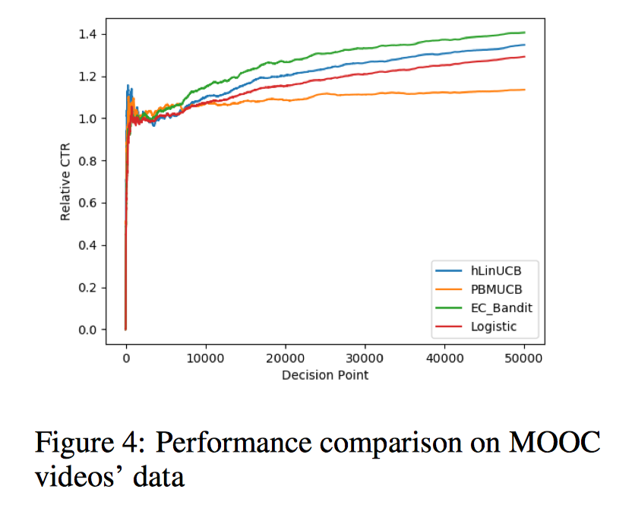
Evaluation – Empirical data

Slide 45
Conclusion
Explicitly modeling implicit feedback as composition of examination and relevance judgement provides finer modeling and leads to better result.
Further work:
Quantitative analysis on the impact of approximated posterior on the cumulative regret;
Generalization from one item’s recommendation to multiple items case.

Slide 46
XiaoMU (小木)
User Modeling
Intervention
Content Analysis

Slide 47
Recent Publications
Yi Qi, Qingyun Wu, Hongning Wang, Jie Tang, and Maosong Sun. Bandit Learning with Implicit Feedback. NIPS'18.
Liangming Pan, Chengjiang Li, Juanzi Li, and Jie Tang. Prerequisite Relation Learning for Concepts in MOOCs. ACL'17.
Xia Jing, Jie Tang, Wenguang Chen, Maosong Sun, and Zhengyang Song. Guess You Like: Course Recommendation in MOOCs. WI'17.
Han Zhang, Maosong Sun, Xiaochen Wang, Zhengyang Song, Jie Tang, and Jimeng Sun. 2017. Smart Jump: Automated Navigation Suggestion for Videos in MOOCs. WWW'17 Companion.
Jiezhong Qiu, Jie Tang, Tracy Xiao Liu, Jie Gong, Chenhui Zhang, Qian Zhang, and Yufei Xue. 2016. Modeling and Predicting Learning Behavior in MOOCs. WSDM'16. 93–102.
Jie Gong, Tracy Xiao Liu, Jie Tang, and Fang Zhang. Incentive Design on MOOC: a Field Experiment on XuetangX, Management Science (top in management). Submitted.
Jie Tang, Tracy Xiao Liu, Zhenyang Song, Xiaochen Wang, Xia Jing, Jiezhong Qiu, Zhenhuan Chen, Chaoyang Li, Han Zhang, Liangmin Pan, Yi Qi, Xiuli Li, Jian Guan, Juanzi Li, and Maosong Sun. LittleMU: Enhancing Learning Engagement Using Intelligent Interaction on MOOCs. submitted to KDD.
李曼丽, 徐舜平, 孙梦嫽. MOOC 学习者课程学习行为分析——以 “电路原理” 课程为例[J]. 开放教育研究, 2015, 21(2): 63-69.
薛宇飞, 黄振中, 石菲. MOOC 学习行为的国际比较研究--以 “财务分析与决策” 课程为例[J]. 开放教育研究, 2015 (2015 年 06): 80-85.
薛宇飞，敬峡，裘捷中，唐杰，孙茂松. 一种在线课程中的作业互评方法：中国，201510531490.2.（中国专利申请号）
唐杰,张茜,刘德兵. 用户退课行为预测方法及装置. 201610292389.0 （中国专利申请号）

Slide 48
Thank you！
Collaborators: Jian Guan, Xiuli Li, Fenghua Nie (XuetangX)
Jie Gong (NUS), Jimeng Sun (GIT)
Wendy Hall (Southampton)
Maosong Sun, Tracy Liu, Juanzi Li (THU)
Xia Jing, Zhenhuan Chen, Liangmin Pan, Jiezhong Qiu, Han Zhang, Zhengyang Song, Xiaochen Wang, Chaoyang Li, Yi Qi (THU)
Jie Tang, KEG, Tsinghua U, http://keg.cs.tsinghua.edu.cn/jietang
Download all data & Codes, http://arnetminer.org/data http://arnetminer.org/data-sna

